Slide 1
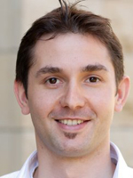
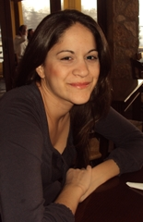
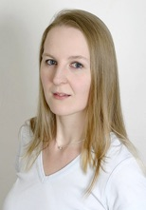
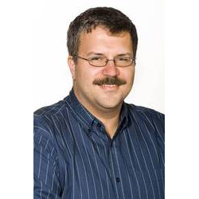

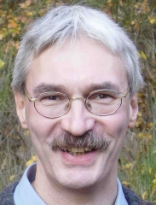
Information Extraction & Automatic Knowledge Base
Construction
Martin Theobald
Ulm University
Iris Miliaraki
Yahoo! Research
Katja Hose
Aalborg University
Ralf Schenkel
University Passau
Fabian Suchanek
Télécom ParisTech
Gerhard Weikum
Max Planck Institute Informatics

Slide 2
All Course Material
http://r.jyu.fi/dzg

Slide 3
History of this Lecture
From Information to Knowledge: Harvesting Entities and Relationships from Web Sources at PODS 2010, Indianapolis, June 2010
Harvesting Knowledge from Web Data and Text at CIKM 2010, Toronto, October 2010
Semantic Knowledge Bases from Web Sources at IJCAI 2011, Barcelona, July 2011
Database Foundations for Scalable RDF Processing at the Reasoning Web 2011 Summer School, Galway, August 2011
Database Techniques for Linked Data Management at Sigmod 2012, Scottsdale, June 2012
Scalable RDF Data Management at the 2nd Workshop on Open Data (WOD), LIP6, Paris, May 2013
Knowledge Harvesting in the Big-Data Era at Sigmod 2013, New York, June 2013
Knowledge Bases in the Age of Big Data Analytics at VLDB 2014, Hangzhou, September 2014
Querying and Learning in Probabilistic Databases at the Reasoning Web 2014 Summer School, Athens, September 2014
Knowledge Bases for Web Content Analytics at WWW 2015, Florence, May 2015

Slide 4
Gerhard Weikum and Martin Theobald From information to knowledge: harvesting entities and relationships from web sources. Proceedings of the 29th ACM SIGMOD-SIGACT-SIGART Symposium on Principles of Database Systems (PODS), 2010
References & Contact Info
Comprehensive lists of references:
Fabian Suchanek and Gerhard Weikum: Knowledge Bases in the Age of Big Data Analytics. Proceedings of the 40th International Conference on Very Large Databases (VLDB), 2014
Please feel free to send any kind of questions or comments to: martin.theobald@uni-ulm.de

Slide 5
Outline
Motivation and Overview
Taxonomic Knowledge:
Entities and Classes
Factual Knowledge:
Relations between Entities
Emerging Knowledge:
New Entities & Relations
Temporal Knowledge:
Validity Times of Facts
Contextual Knowledge:
Entity Disambiguation & Linkage
Commonsense Knowledge:
Properties & Rules
Wrap-up & Results of the IE Challenge

Slide 6

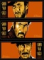
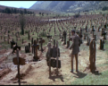










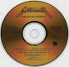
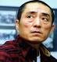
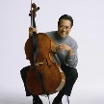

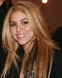


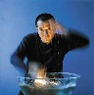
Turn Web into Knowledge Base
more knowledge, analytics, insight
knowledge
acquisition
Web
Contents
Knowledge
intelligent
interpretation

Slide 7
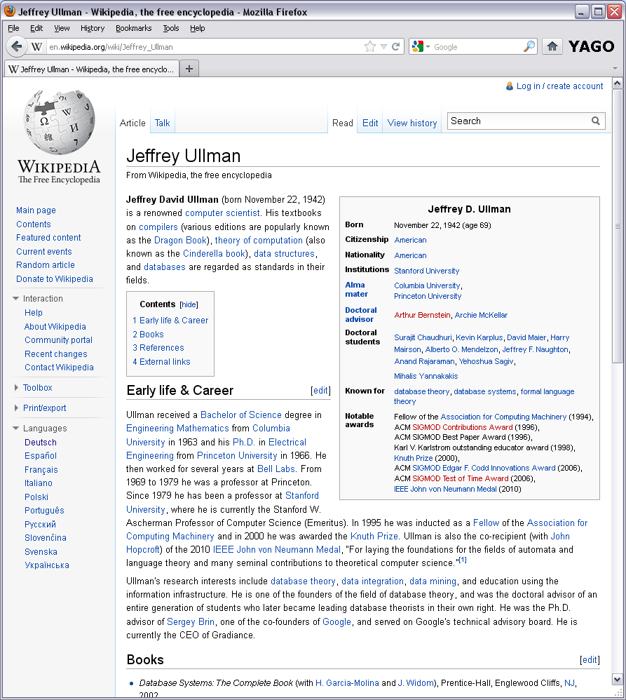
Information Extraction
YAGO/DBpedia et al.
bornOn(Jeff, 09/22/42)
gradFrom(Jeff, Columbia)
hasAdvisor(Jeff, Arthur)
hasAdvisor(Surajit, Jeff)
knownFor(Jeff, Theory)
>120 M facts for YAGO2
(mostly from Wikipedia infoboxes)
New fact candidates
type(Jeff, Author)
author(Jeff, Drag_Book)
author(Jeff,Cind_Book)
worksAt(Jeff, Bell_Labs)
type(Jeff, CEO)
100’s M additional facts
from Wikipedia free-text

Slide 8
YAGO2 Knowledge Base
10M entities
120M facts for
100 relations
95% accuracy
Entity
subClassOf
Organization
Person
subClassOf
subClassOf
Location
subClassOf
subClassOf
subClassOf
Scientist
Politician
subClassOf
subClassOf
Country
subClassOf
subClassOf
State
Biologist
type
type
Physicist
type
City
Germany
type
type
type
locatedIn
Oct 23, 1944
Erwin_Planck
diedOn
Kiel
locatedIn
Schleswig-Holstein
type
fatherOf
bornIn
Nobel Prize
hasWon
citizenOf
Oct 4, 1947
diedOn
Max_Planck Society
Max_Planck
Angela Merkel
Apr 23, 1858
bornOn
means
means
means
means
means
"Max Planck"
"Max Karl Ernst Ludwig Planck"
"Angela Merkel"
"Angela Dorothea Merkel"
http://www.mpi-inf.mpg.de/yago-naga/

Slide 9
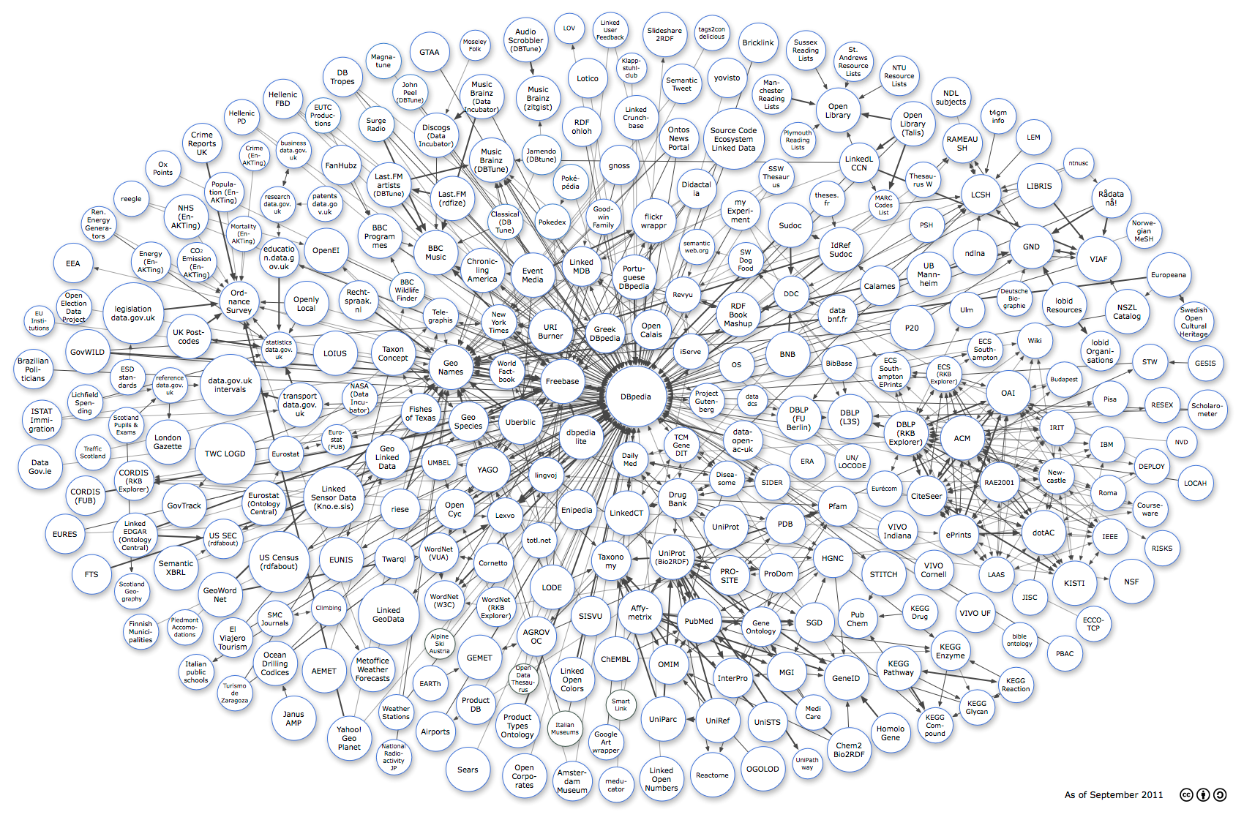
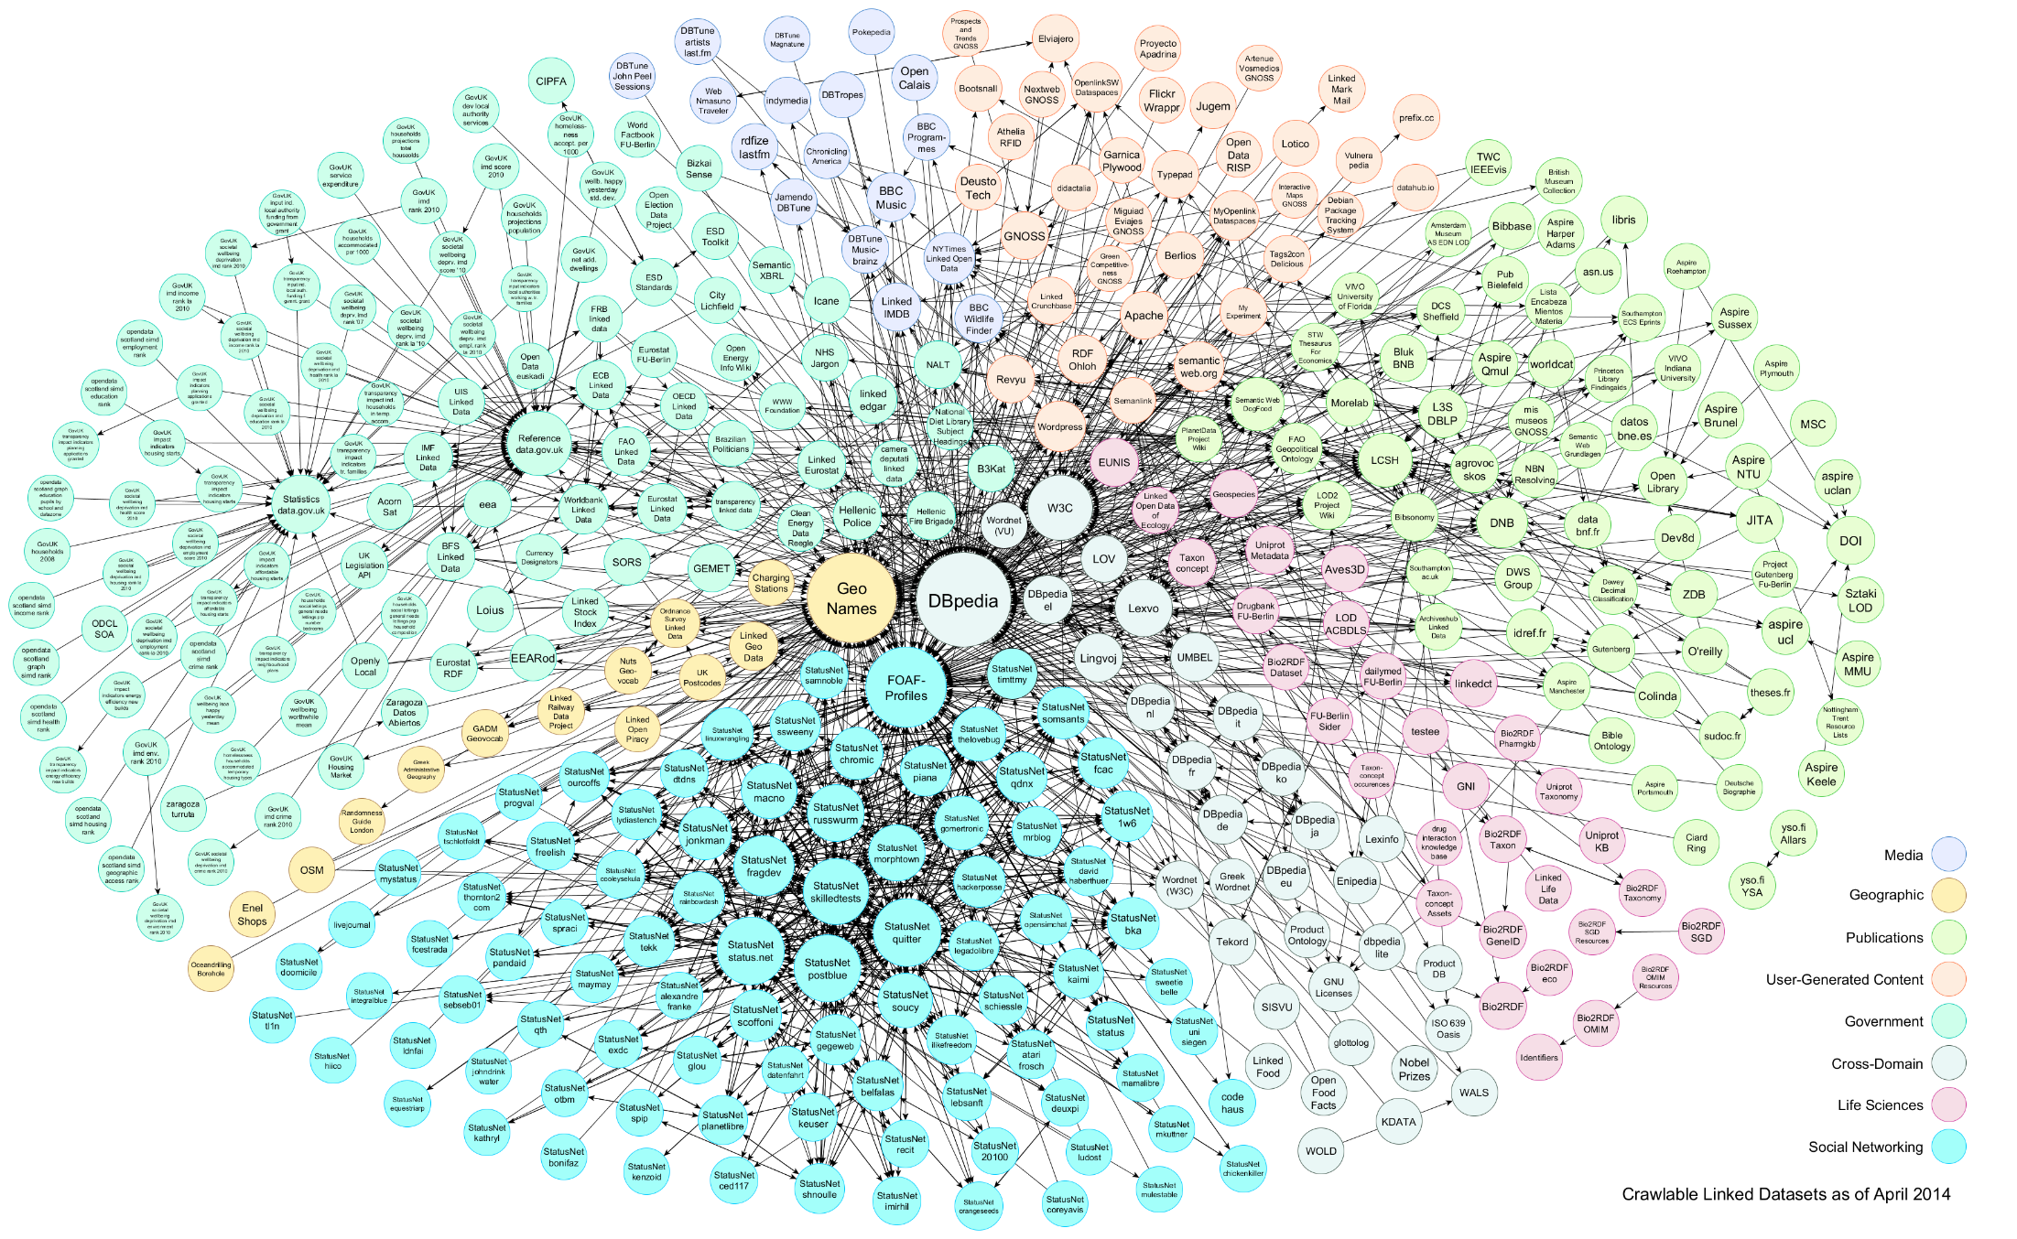
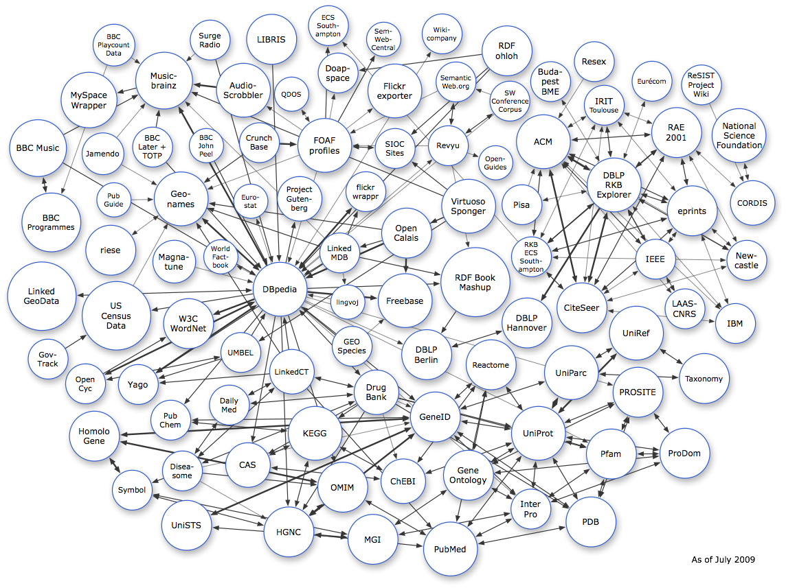
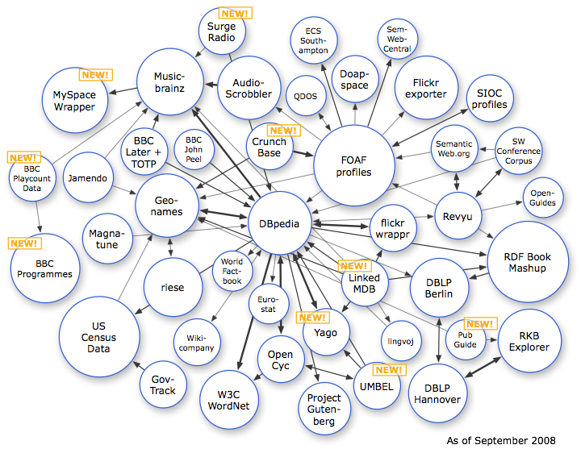
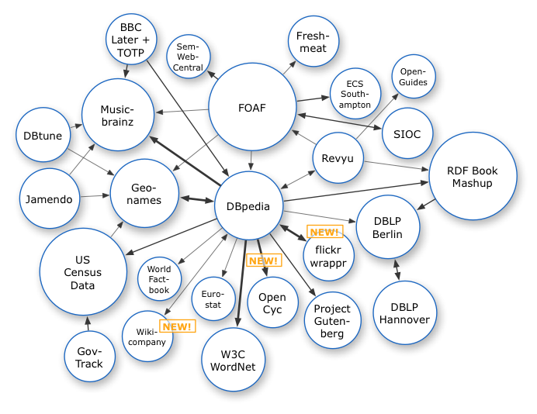
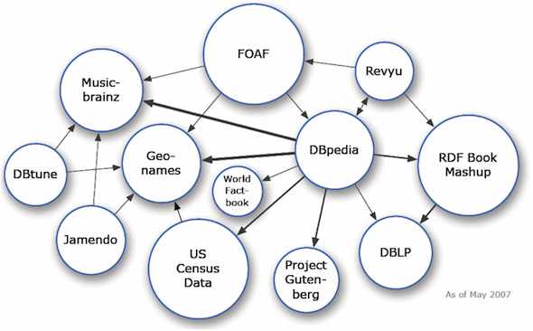
Linked Open Data (LOD) Cloud
http://linkeddata.org/

Slide 10









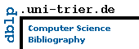










Web of Data & Knowledge (Linked Open Data)
> 60 Bio. subject-predicate-object triples from > 1000 sources
ReadTheWeb
Cyc
SUMO
BabelNet
TextRunner/
ReVerb
WikiTaxonomy/
WikiNet
ConceptNet 5
http://richard.cyganiak.de/2007/10/lod/lod-datasets_2011-09-19_colored.png

Slide 11
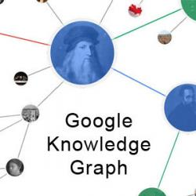
Web of Data & Knowledge
> 60 Bio. subject-predicate-object triples from > 1000 sources
4M entities in
250 classes
500M facts for
6000 properties
live updates
600M entities in
15000 topics
20B facts
10M entities in
350K classes
120M facts for
100 relations
100 languages
95% accuracy
40M entities in
15000 topics
1B facts for
4000 properties
core of Google
Knowledge Graph

Slide 12
Web of Data & Knowledge
> 60 Bio. subject-predicate-object triples from > 1000 sources
Yimou_Zhang type movie_director
Yimou_Zhang type olympic_games_participant
movie_director subClassOf artist
Yimou_Zhang directed Flowers_of_War
Christian_Bale actedIn Flowers_of_War
id11: Yimou_Zhang memberOf Beijing_film_academy
id11 validDuring [1978, 1982]
Yimou_Zhang "was classmate of" Kaige_Chen
Yimou_Zhang "had love affair with" Li_Gong
Li_Gong knownAs "China's most beautiful"
taxonomic knowledge
factual knowledge
temporal knowledge
emerging knowledge
terminological knowledge
http://richard.cyganiak.de/2007/10/lod/lod-datasets_2011-09-19_colored.png

Slide 13
Knowledge Bases: a Pragmatic Definition
Comprehensive and semantically organized
machine-readable collection of
universally relevant or domain-specific
entities, classes, and
SPO facts (attributes, relations)
plus spatial and temporal dimensions
plus commonsense properties and rules
plus contexts of entities and facts
(textual & visual witnesses, descriptors, statistics)
plus …..

Slide 14
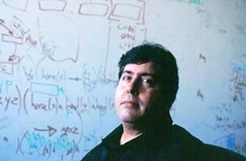
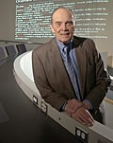

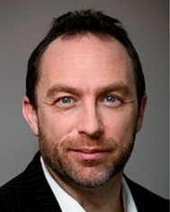
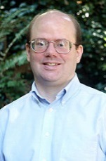

History of Digital Knowledge Bases
Cyc
WordNet
from humans
for humans
from algorithms
for machines
guitarist ⊂ {player,musician}
⊂ artist
algebraist
mathematician
scientist
Wikipedia
∀ x: human(x) ⇒
(∃ y: mother(x,y) ∧
∃ z: father(x,z))
∀ x,u,w: (mother(x,u) ∧
mother(x,w)
⇒ u=w)
4.5 Mio. English articles
20 Mio. contributors
1985
1990
2000
2005
2010

Slide 15
(Some) Open Knowledge Bases
YAGO: yago-knowledge.org
DBpedia: dbpedia.org
Freebase: freebase.com
Entitycube: entitycube.research.microsoft.com
renlifang.msra.cn
NELL: rtw.ml.cmu.edu
DeepDive: deepdive.stanford.edu
Probase: research.microsoft.com/en-us/projects/probase/
KnowItAll / ReVerb: openie.cs.washington.edu
reverb.cs.washington.edu
BabelNet: babelnet.org
WikiNet: www.h-its.org/english/research/nlp/download/
ConceptNet: conceptnet5.media.mit.edu (mostly Wiktionary)
WordNet: wordnet.princeton.edu
Linked Open Data: linkeddata.org

Slide 16
Knowledge for Intelligence
Enabling technology for:
disambiguation in written & spoken natural language
deep reasoning (e.g. QA to win quiz game)
machine reading (e.g. to summarize book or corpus)
semantic search in terms of entities&relations (not keywords&pages)
entity-level linkage for Big Data
Politicians who are also scientists?
European composers who have won film music awards?
Chinese professors who founded Internet companies?
Relationships between
John Lennon, Billie Holiday, Heath Ledger, King Kong?
Enzymes that inhibit HIV?
Influenza drugs for teens with high blood pressure?
...

Slide 17
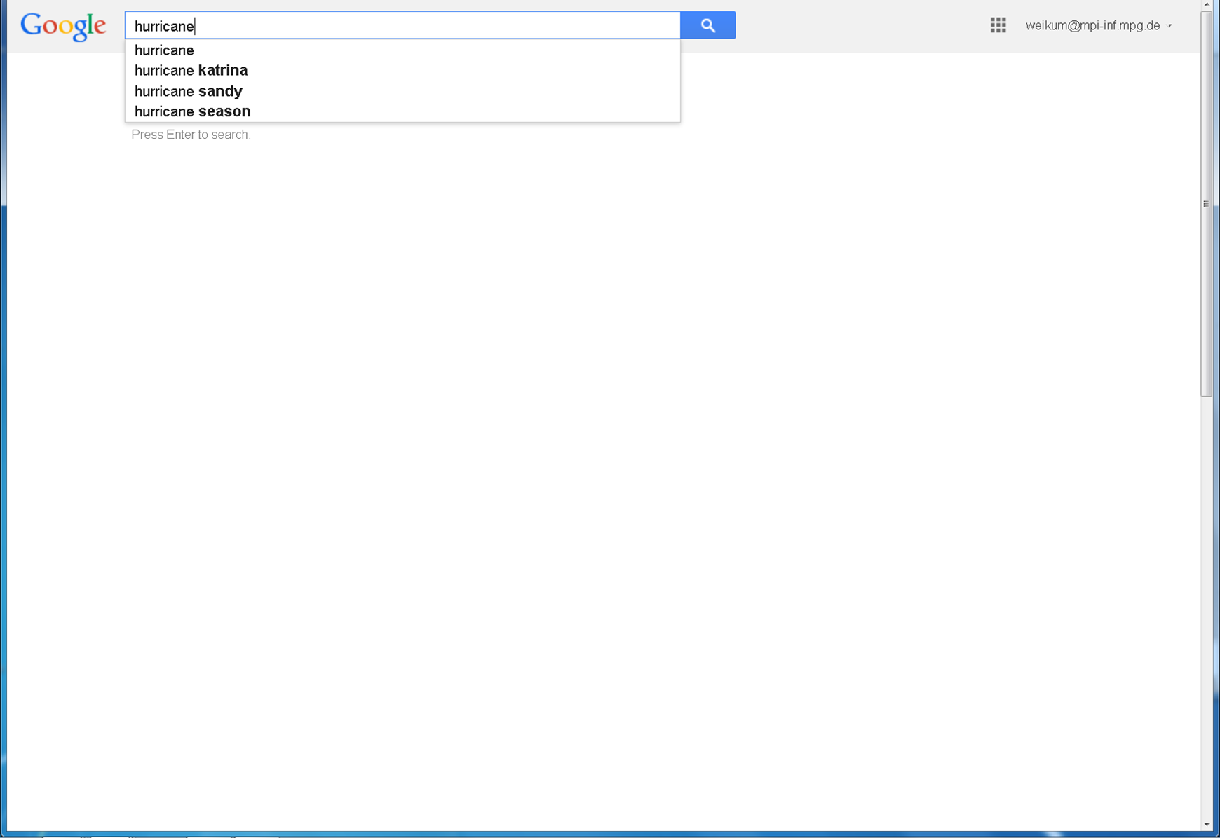
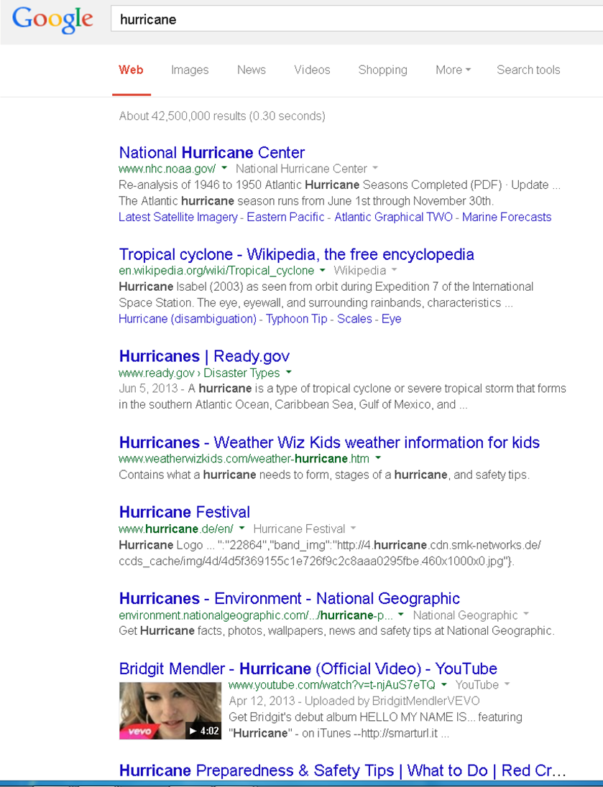
Use-Case: Internet Search

Slide 18
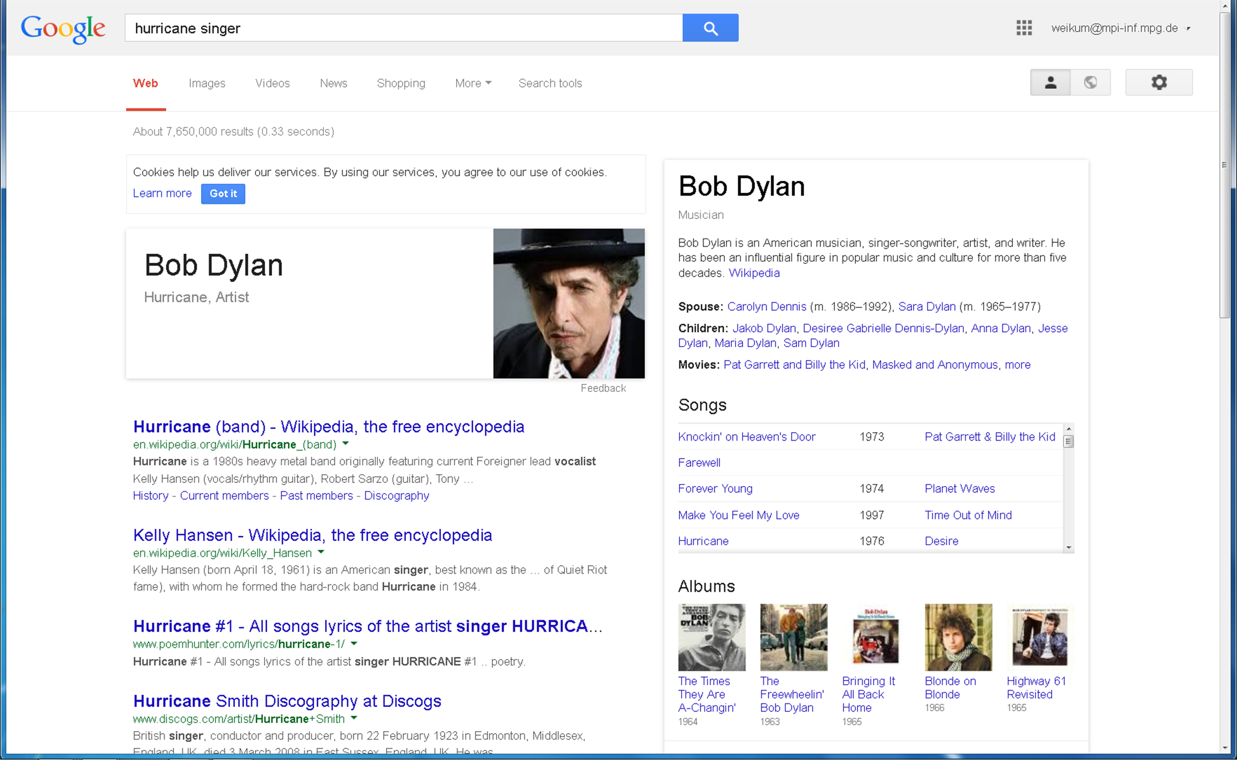
Google Knowledge Graph
(Google Blog: "Things, not Strings", 16 May 2012)

Slide 19
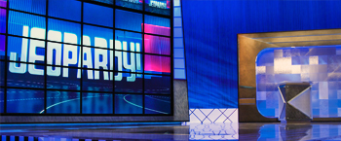
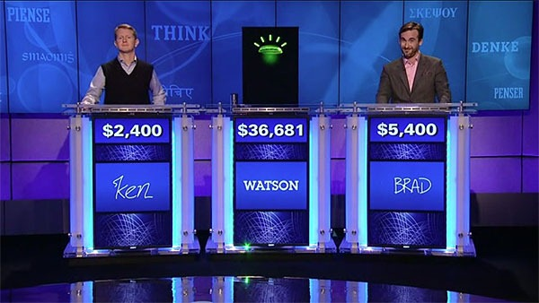


Use Case: Question Answering
This town is known as "Sin City" & its downtown is "Glitter Gulch"
Q: Sin City ?
→ movie, graphical novel, nickname for city, …
A: Vegas ? Strip ?
→ Vega (star), Suzanne Vega, Vincent Vega, Las Vegas, …
→ comic strip, striptease, Las Vegas Strip, …
This American city has two airports
named after a war hero and a WW II battle
question
classification &
decomposition
knowledge
back-ends
D. Ferrucci et al.: Building Watson: An Overview of the DeepQA Project. AI Magazine, Fall 2010.
www.ibm.com/innovation/us/watson/index.htm

Slide 20
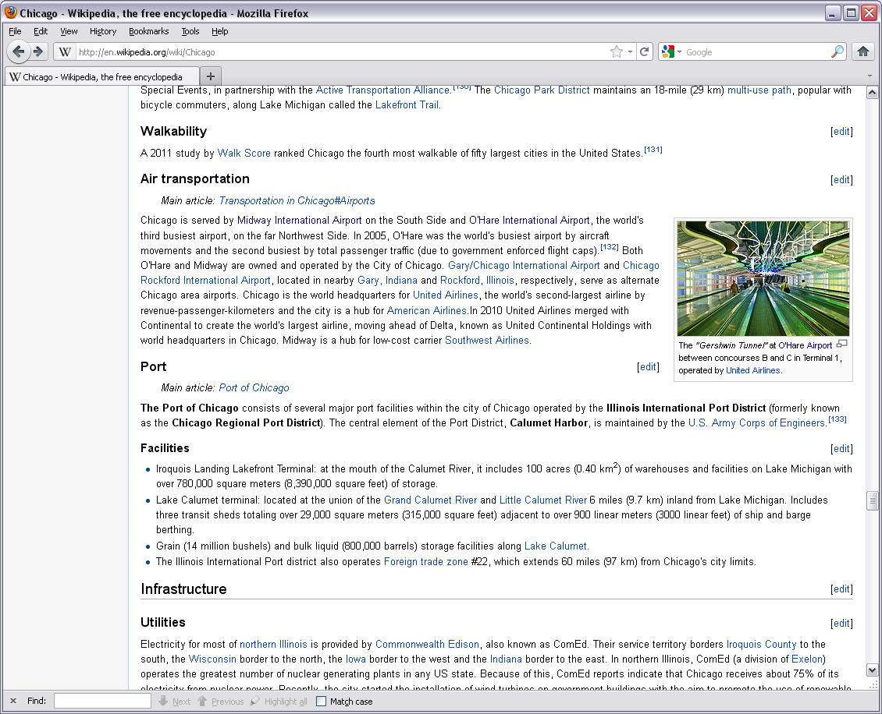
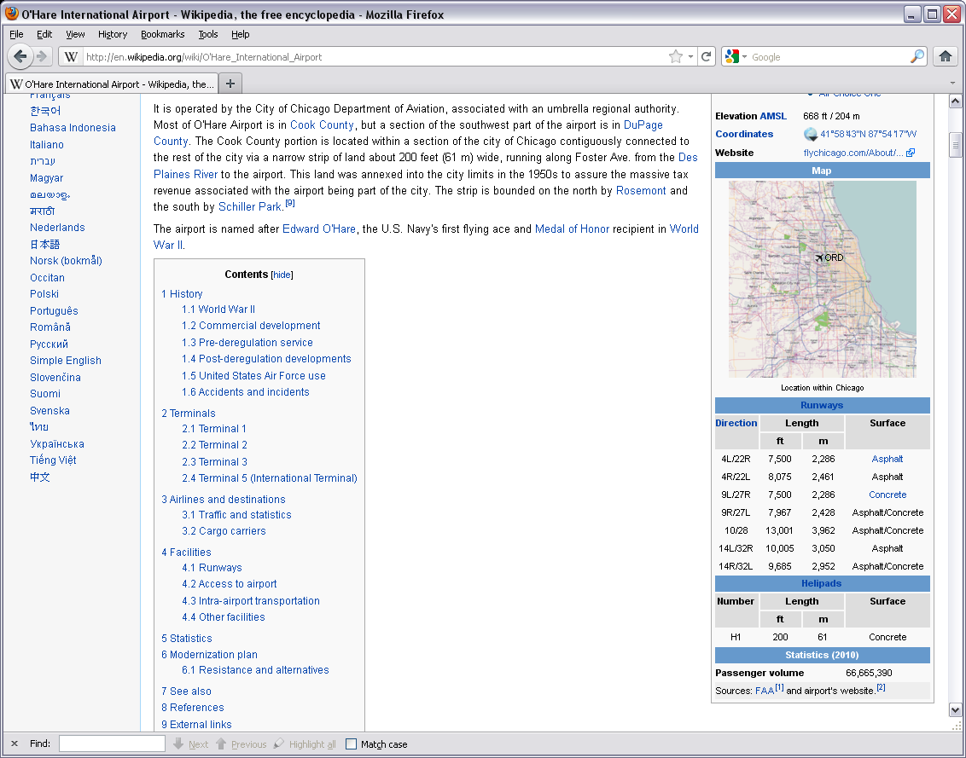
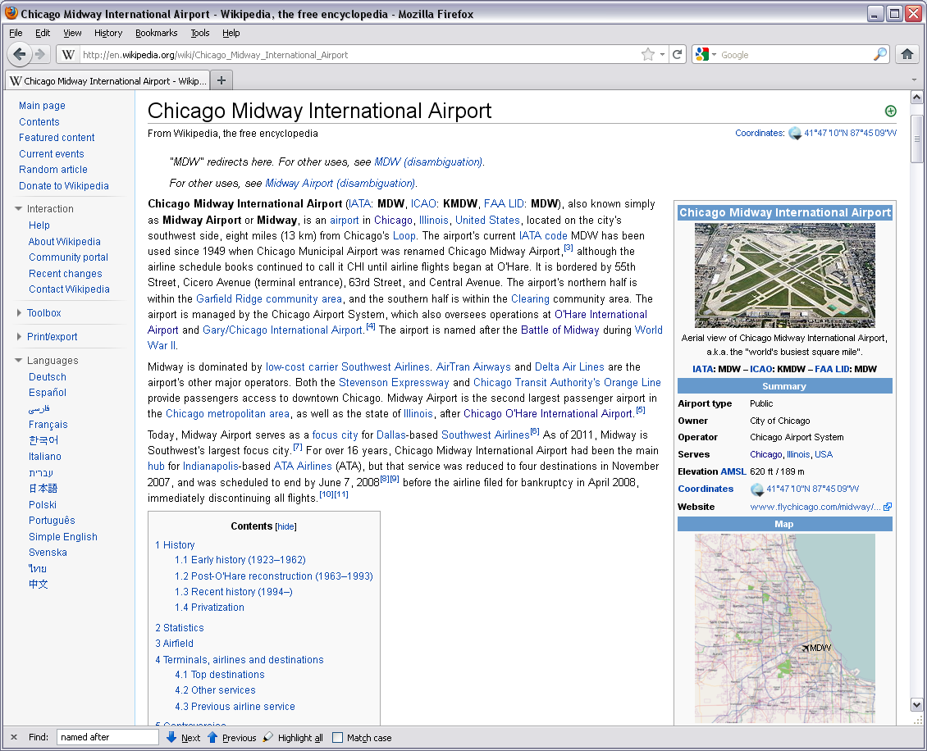
Playing Jeopardy!
This American city has two airports, one named after a WW II hero and one named after a WW II battle field.

Slide 21
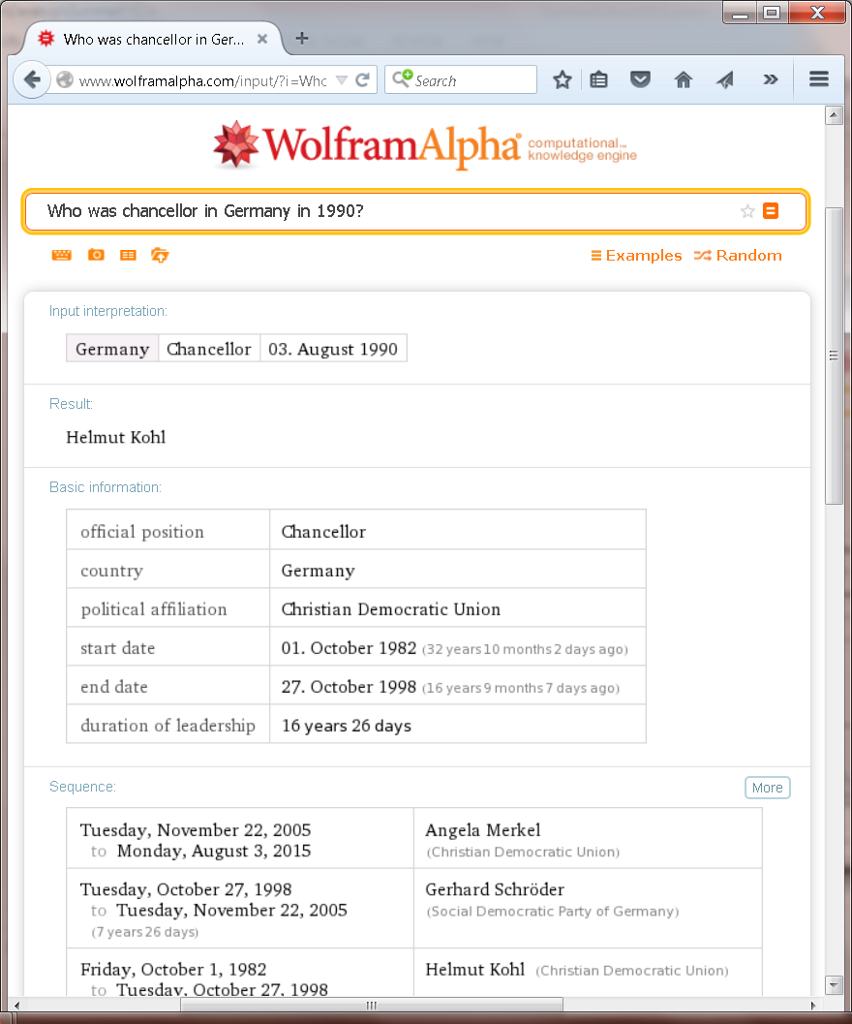
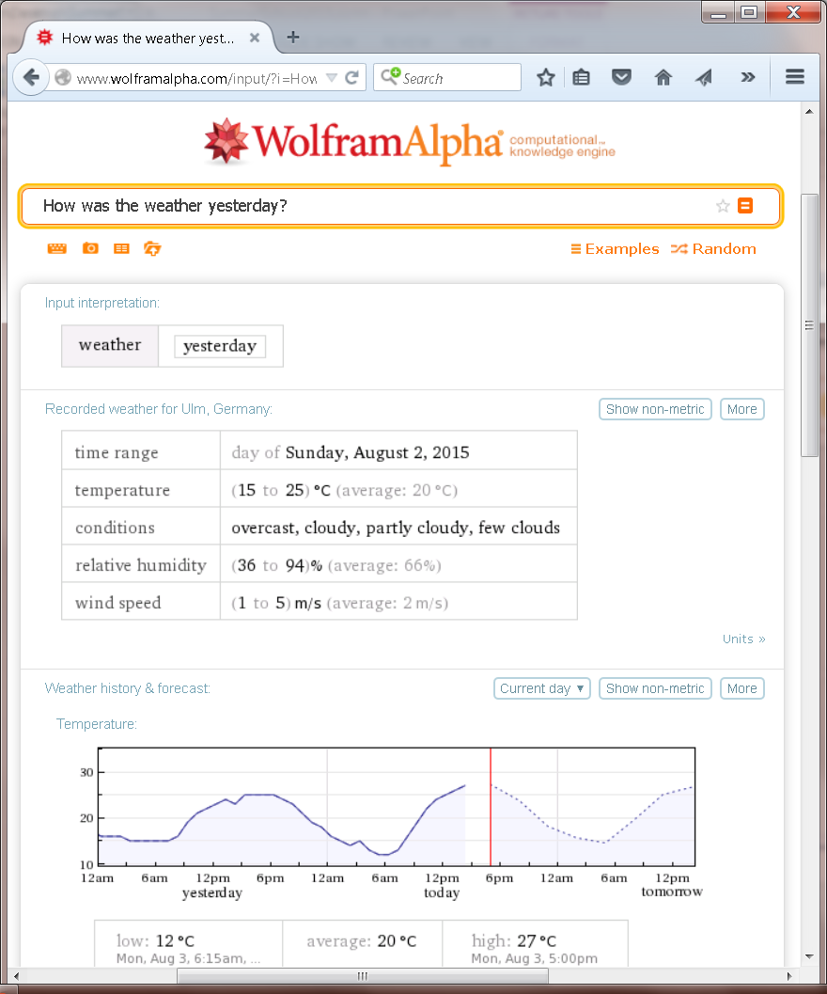
Wolfram Alpha

Slide 22

Use Case: Machine Reading
It's about the disappearance forty years ago of Harriet Vanger, a young
scion of one of the wealthiest families in Sweden, and about her uncle,
determined to know the truth about what he believes was her murder.
Blomkvist visits Henrik Vanger at his estate on the tiny island of Hedeby.
The old man draws Blomkvist in by promising solid evidence against Wennerström. Blomkvist agrees to spend a year writing the Vanger family history as a cover for the real assignment: the disappearance of Vanger's niece Harriet some 40 years earlier. Hedeby is home to several generations of Vangers, all part owners in Vanger Enterprises. Blomkvist becomes acquainted with the members of the extended Vanger family, most of whom resent his presence. He does, however, start a short lived affair with Cecilia, the niece of Henrik.
After discovering that Salander has hacked into his computer, he persuades her to assist
him with research. They eventually become lovers, but Blomkvist has trouble getting close to Lisbeth who treats virtually everyone she meets with hostility. Ultimately the two discover that Harriet's brother Martin, CEO of Vanger Industries, is secretly a serial killer.
A 24-year-old computer hacker sporting an assortment of tattoos and body piercings supports herself by doing deep background investigations for Dragan Armansky, who, in turn, worries that Lisbeth Salander is "the perfect victim for anyone who wished her ill."
same
same
same
owns
uncleOf
hires
enemyOf
same
affairWith
same
affairWith
headOf
same
Etzioni, Banko, Cafarella: Machine Reading. AAAI'06
Mitchell, Carlson et al.: Toward an Architecture for Never-Ending Language Learning. AAAI'10

Slide 23
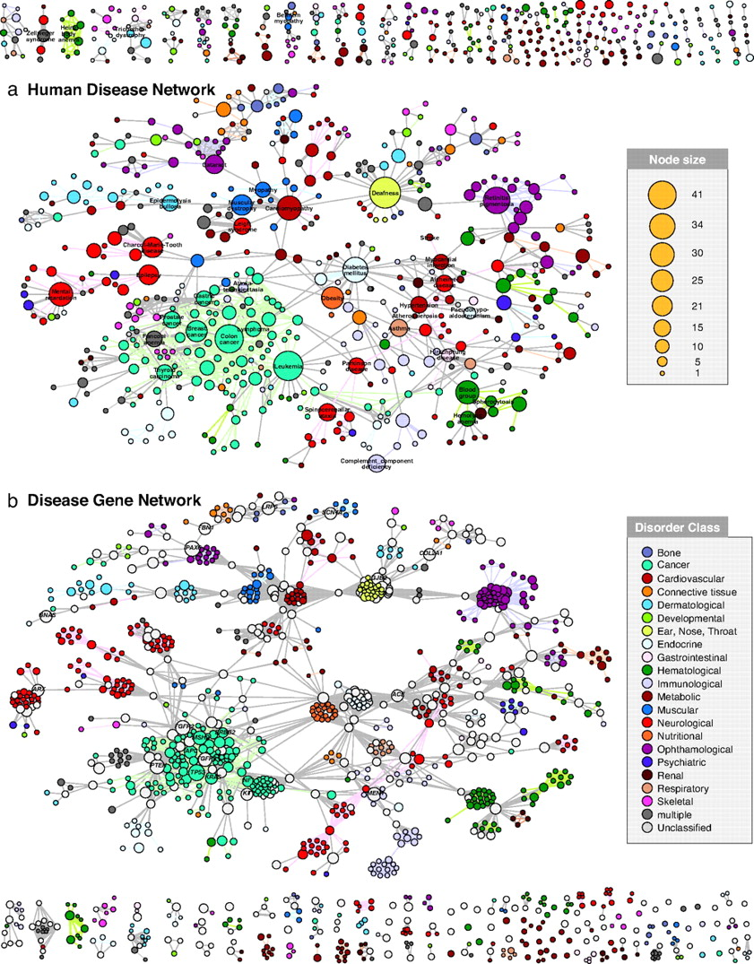

Use Case: Text Analytics (Disease Networks)
Add genetic & pathway data,
patient data, reports in social media, etc.
→ bottlenecks: data variety & data veracity
→ key asset: digital background knowledge
for data cleaning, fusion, sense-making
Need to understand
synonyms vs. homonyms
of entities & relations
(Google: "things, not strings")
But try this with:
diabetes mellitus, diabetes type 1, diabetes type 2, diabetes insipidus,
insulin-dependent diabetes mellitus with ophthalmic complications,
ICD-10 E23.2, OMIM 304800, MeSH C18.452.394.750, MeSH D003924, …
K.Goh,M.Kusick,D.Valle,B.Childs,M.Vidal,A.Barabasi: The Human Disease Network, PNAS, May 2007

Slide 24



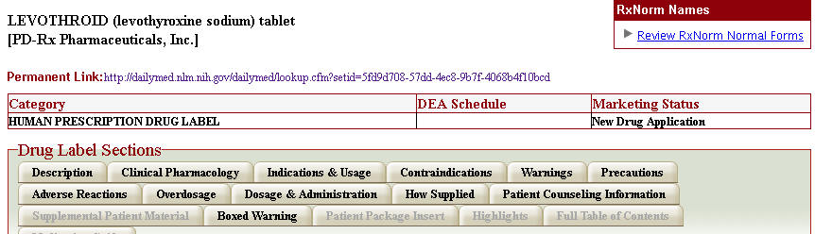
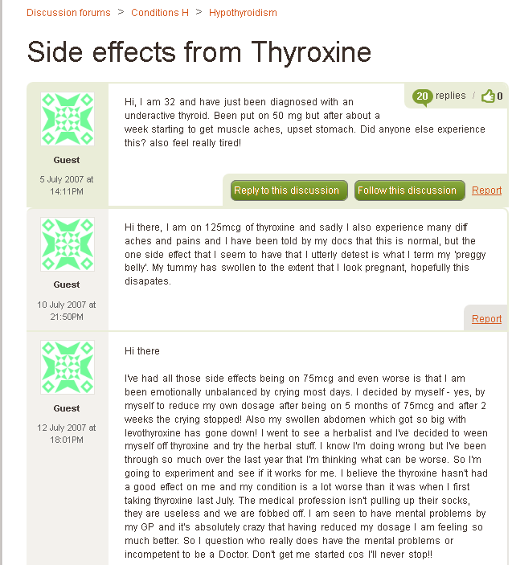
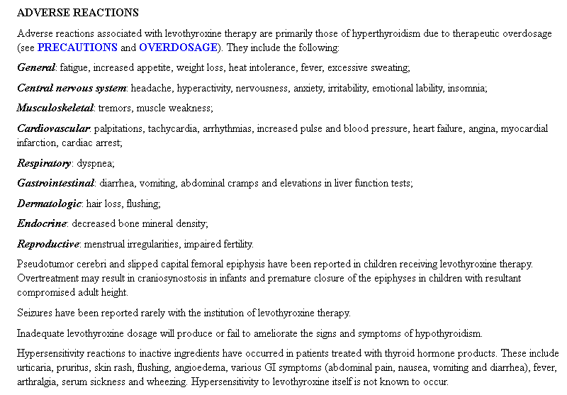
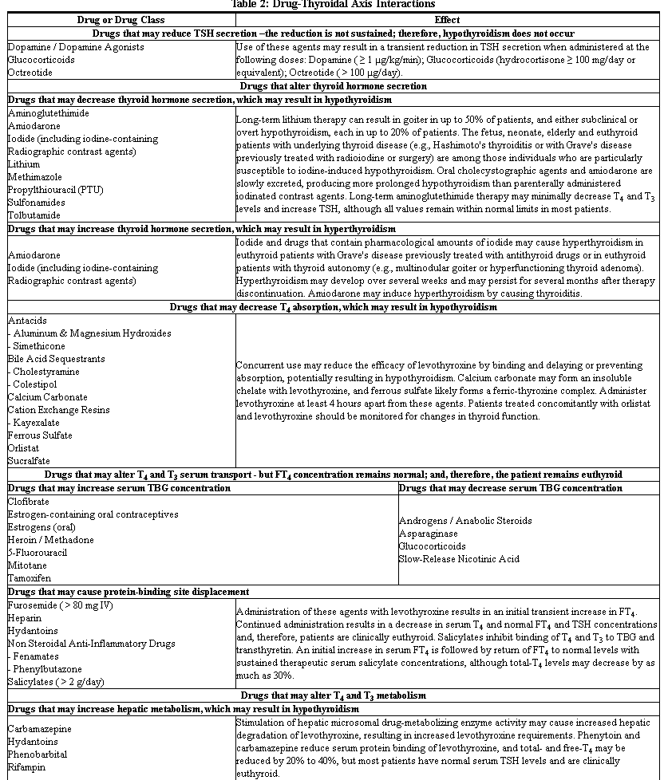

Use Case: Big Data Analytics (Side Effects of Drug Combinations)
Deeper insight from both
expert data & social media:
actual side effects of drugs
… and drug combinations
risk factors and complications
of (wide-spread) diseases
alternative therapies
aggregation & comparison by
age, gender, life style, etc.
Structured
Expert Data
Social
Media
Harness knowledge base(s) on
diseases, symptoms, drugs, biochemistry,
food, demography, geography, culture, life style,
jobs, transportation, etc. etc.
http://dailymed.nlm.nih.gov
http://www.patient.co.uk

Slide 25
Big Data + Text Analytics
Health:
Drugs (combinations) and their side effects
Entertainment:
Who covered which other singer?
Who influenced which other musicians?
Politics:
Politicians' positions on controversial topics
and their involvement with industry
Business:
Customer opinions on small-company products,
gathered from social media
Culturomics:
Trends in society, cultural factors, etc.
General Design Pattern:
Identify relevant contents sources
Identify entities of interest & their relationships
Position in time & space
Group and aggregate
Find insightful patterns & predict trends

Slide 26
Knowledge Bases & Big Data Analytics
Big Data Analytics
Scalable algorithms
Distributed platforms
Discovering data sources
Knowledge
Bases:
entities,
relations,
time, space,
…
Tapping unstructured data
Connecting structured &
unstructured data sources
Making sense of
heterogeneous, dirty,
or uncertain data

Slide 27
Jyväskylä Summer School: IE Challenge
Create your own knowledge base from
Wikipedia articles about "Scientists"
(2) Extract binary relations with facts about persons, organizations, locations and other entity types
(3) Integrate your facts into the YAGO2 knowledge base

Slide 28
Jyväskylä Summer School: IE Challenge
Download dump of 10 900 Wikipedia articles about "Scientists" (available both with/without Wiki links)
2. Basic text processing and parsing:
Stanford CoreNLP toolsuite
3. Background knowledge: YAGO2 ("core" facts)
4. NER and NED: AIDA entity disambiguation tool
5. Pattern matching: PROSPERA/PATTY collection
of string-pattern-to-relation mappings
6. Probabilistic inference (optional) via
Markov Logic Networks: using either
Alchemy 2.0, Tuffy 0.4 or Markov – TheBeast

Slide 29
Jyväskylä Summer School: IE Challenge
You may choose to pursue either one of the following two challenges:
1. Recall Challenge
Extract as many new facts (instances of binary relations not yet contained in YAGO2) as possible,
you must achieve at least 50% precision.
2. Precision Challenge
Extract at least 10 000 new facts (instances of binary relations not yet contained in YAGO2),
you must achieve at least 80% precision.
Both challenges may be pursued in teams of up to 4 students. Please send the names of your team members to martin.theobald@uni-ulm.de by tonight!

Slide 30
Jyväskylä Summer School: IE Challenge
Compute Wilson confidence interval for the (estimated) precision over n i.i.d samples drawn from Binomial distribution with unknown parameter p.
Pick a significance level α (usually set α = 5%)
Manually assess n (e.g., n = 100) newly extracted, randomly chosen facts; let k denote the amount of correct facts out of the set of n facts you assessed.
Compute the Wilson interval for p_{low}, p_{up} by approximating the Binomial distribution with a Standard-Normal distribution Φ:
If the width of your interval at α = 0.05 is larger than about 0.06, then increase n and repeat from Step 2.

Slide 31
Outline

Motivation and Overview
Taxonomic Knowledge:
Entities and Classes
✶ Scope & Goal
✶ Wikipedia-centric Methods
✶ Web-based Methods
Factual Knowledge:
Relations between Entities
Emerging Knowledge:
New Entities & Relations
Temporal Knowledge:
Validity Times of Facts
Contextual Knowledge:
Entity Disambiguation & Linkage
Commonsense Knowledge:
Properties & Rules
Wrap-up & Results of the IE Challenge

Slide 32
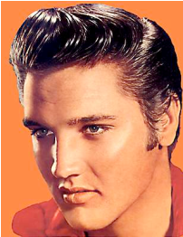
Knowledge Bases are Labeled Graphs
resource
subClassOf
subClassOf
Classes/
Concepts/
Types
person
location
subClassOf
singer
city
type
Relations/
Predicates
type
bornIn
Instances/
entities
Tupelo
A knowledge base can be seen as a directed labeled multi-graph,
where the nodes are entities and the edge labels are the relations.

Slide 33
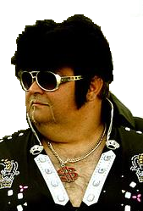
An entity can have different labels
The same entity
has two labels:
synonymy
person
singer
The same label for two entities:
ambiguity
type
type
label
label
"The King"
"Elvis"

Slide 34
Different Views of a Knowledge Base
Triple notation:
We use "RDFS Ontology" and "Knowledge Base (KB)"
synonymously.
Subject | Predicate | Object
Elvis | type | singer
Elvis | bornIn | Tupelo
... | ... | ...
Graph notation:
singer
type
Logical notation:
bornIn
Tupelo
type(Elvis, singer)
bornIn(Elvis,Tupelo)
...

Slide 35
Our goal is to find classes & instances
Which classes exist?
(aka entity types, unary predicates, concepts)
person
subClassOf
Which subsumptions hold?
singer
type
Which entities belong to which classes?
Which entities exist?

Slide 36
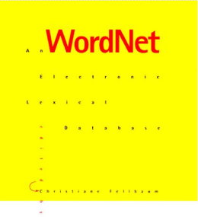


WordNet – A Rich Lexical Knowledge Base
living being
WordNet contains
82,000 classes
subClassOf
label
person
subClassOf
WordNet contains
thousands of subClassOf
relationships
"person"
singer
"individual"
"soul"
WordNet project
(1985-now)
WordNet contains
118,000 class labels

Slide 37
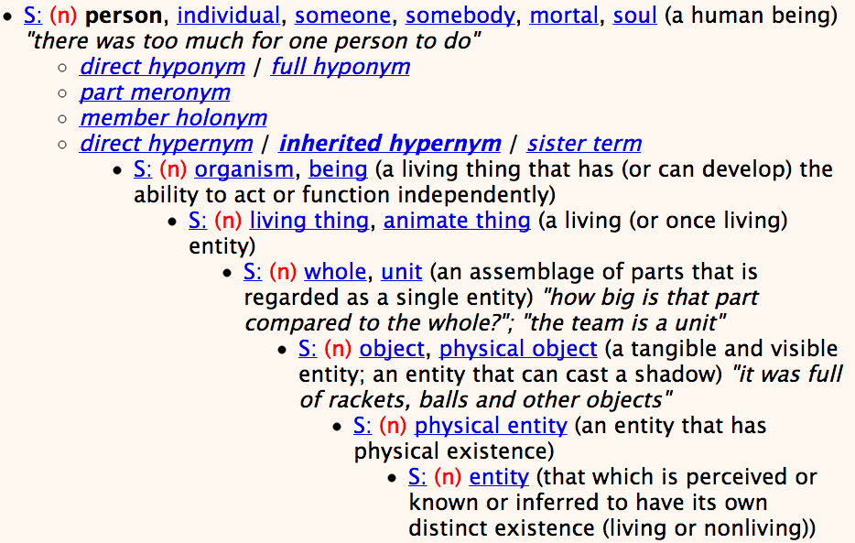
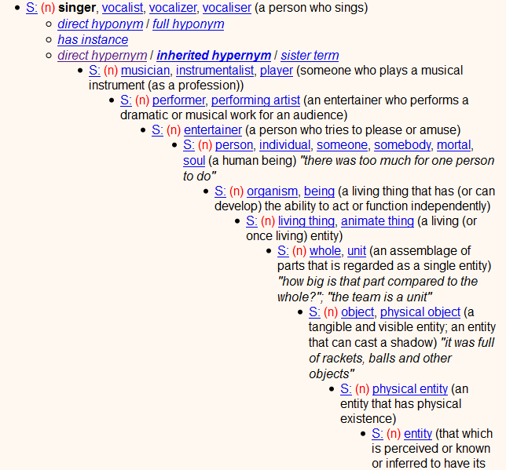
WordNet Example: Superclasses

Slide 38
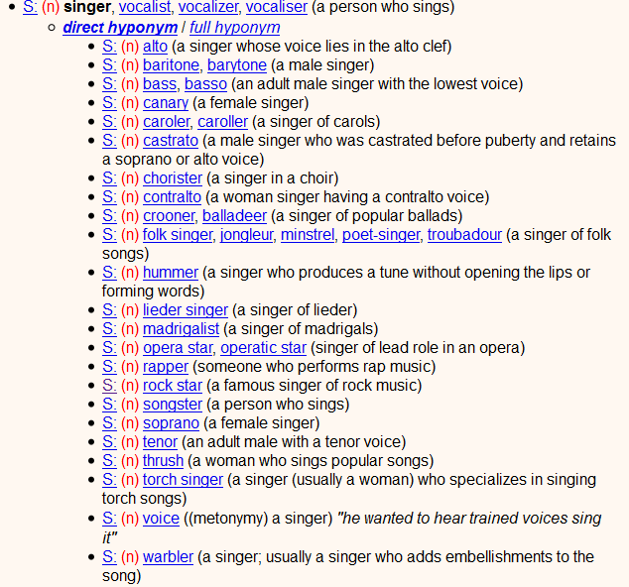
WordNet Example: Subclasses

Slide 39
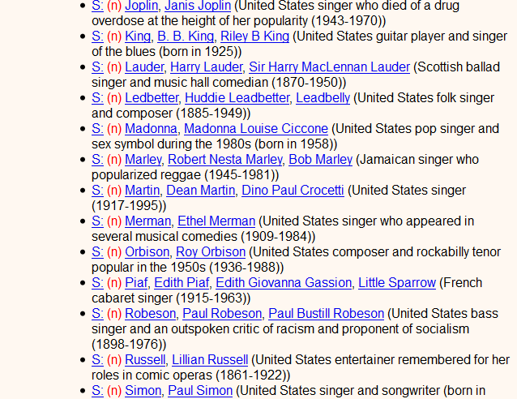
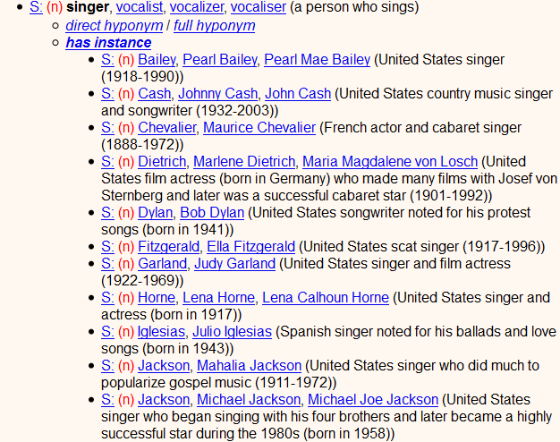
WordNet Example: Instances
only 32 singers !?
4 guitarists
5 scientists
0 enterprises
2 entrepreneurs
WordNet classes
lack instances 

Slide 40
Goal is to Go Beyond WordNet
WordNet is not perfect:
it contains only few instances
it contains only common nouns as classes
it contains only English labels
... but it contains a wealth of information that can be the starting point for further extraction.

Slide 41
Outline

Motivation and Overview
Taxonomic Knowledge:
Entities and Classes
 Basics & Goal
✶ Wikipedia-centric Methods
✶ Web-based Methods
Factual Knowledge:
Relations between Entities
Emerging Knowledge:
New Entities & Relations
Temporal Knowledge:
Validity Times of Facts
Contextual Knowledge:
Entity Disambiguation & Linkage
Commonsense Knowledge:
Properties & Rules
Wrap-up & Results of the IE Challenge

Slide 42
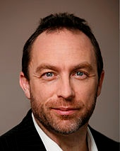
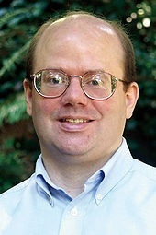

Wikipedia – A Rich Source of Instances
Jimmy
Wales
Larry
Sanger

Slide 43

Wikipedia's Categories Contain Classes
But: categories do not form a taxonomic hierarchy!

Slide 44
Link Wikipedia Categories to WordNet?
American billionaires
Technology company founders
Apple Inc.
Deaths from cancer
Internet pioneers
tycoon, magnate
entrepreneur
?
pioneer, innovator
?
pioneer, colonist
Wikipedia categories
WordNet classes

Slide 45
Categories can be linked to WordNet
singer
gr. person
person
people
descent
WordNet
"singer"
"person"
"people"
"descent"
Most
frequent
meaning
Head has to be plural
person
Stemming
pre-modifier
head
post-modifier
Noungroup
parsing
American people of Syrian descent
American people of Syrian descent
Wikipedia

Slide 46

YAGO = WordNet + Wikipedia
Related project:
WikiTaxonomy
105,000 subClassOf links
88% accuracy
[Ponzetto & Strube: AAAI'07]
200,000 classes
460,000 subClassOf
3 Mio. instances
96% accuracy
[Suchanek: WWW'07]
organism
subClassOf
WordNet
person
subClassOf
American people of Syrian descent
Wikipedia
type
Steve Jobs

Slide 47



Tapping on Wikipedia Categories

Slide 48
Mapping: Wikipedia → WordNet
Missing
Person
Sailor,
Crewman
American
Computer
Scientist
Scientist
Jim Gray
(computer specialist)
Chemist
Artist

Slide 49

Mapping: Wikipedia → WordNet
Missing
Person
Sailor,
Crewman
People
Lost at Sea
?
Computer
Scientists
by Nation
American
type
American
Computer
Scientists
Computer
Scientist
Scientist
subClassOf
Jim Gray
(computer specialist)
Databases
?
Data-
base
Database
Researcher
?
Engineering
Societies
Fellow (1),
Comrade
?
Fellows of
the ACM
?
ACM
Fellow (2),
Colleague
name similarity
(edit dist., n-gram overlap) ?
Members of Learned
Societies
Fellow (3)
(of Society)
context similarity
(word/phrase level) ?
Member (1),
Fellow
?
machine learning ?
Member (2),
Extremity

Slide 50
Mapping: Wikipedia → WordNet
[Suchanek: WWW'07, Ponzetto & Strube:AAAI'07]
Given: entity e in Wikipedia categories c₁, …, c_{k}
Wanted: type(e,c) and subClassOf(c_{i},c) for WN class c
Problem: vagueness & ambiguity of names c₁, …, c_{k}
Analyzing category names → noun group parser:
American Musicians of Italian Descent
pre-modifier
head
post-modifier
American Folk Music of the 20th Century
pre-modifier
head
post-modifier
American Indy 500 Drivers on Pole Positions
pre-modifier
head
post-modifier
Head word is key, should be in plural for rdf:type

Slide 51
Mapping Wikipedia Entities to WordNet Classes
[Suchanek: WWW'07, Ponzetto & Strube: AAAI'07]
Given: entity e in Wikipedia categories c₁, …, c_{k}
Wanted: type(e,c) and subClassOf(c_{i},c) for WN class c
Problem: vagueness & ambiguity of names c₁, …, c_{k}
Heuristic Method:
for each c_{i} do
if head word w of category name c_{i} is plural
{
1) match w against synsets of WordNet classes
2) choose best fitting class c and set e ∈ c
3) expand w by pre-modifier and set c_{i} ⊆ w⁺ ⊆ c
}
tuned conservatively: high precision, reduced recall
can also derive features this way
feed into supervised classifier

Slide 52
Goal: Comprehensive & Consistent !
Telecomm.
History
Doctoral
Students
Knuth Prize
Laureate
American
…
Bell Labs
Known
For
Princeton
Alumni
Academic
Jeffrey
Ullman
American
People by
Occupation
Alma
Mater
American
Computer
Scientists
Scientist
Notable
Awards
Jim Gray
(computer specialist)
Databases
Database
Researcher
Fellow(1)
Computer
Data
Fellow(2)
Born
Fellows of
the ACM
Members of Learned
Societies
Award
Winner
Years
Active
Madonna
(entertainer)
U Michigan
Alumni
Athlete
Genres
Americans of
Italian Descent
World
Record
Holders
Artist
Also
Known
As
Bob Dylan
People
by Status
Musician
American
Songwriters
…
Hall of Fame
Inductees
Website
Singer
Guitar Players
Italian

Slide 53
Goal: Comprehensive & Consistent !
Telecomm.
History
Doctoral
Students
Knuth Prize
Laureate
American
…
Bell Labs
Known
For
Princeton
Alumni
Academic
Jeffrey
Ullman
American
People by
Occupation
Alma
Mater
American
Computer
Scientists
Scientist
Notable
Awards
Jim Gray
(computer specialist)
Databases
Database
Researcher
Fellow(1)
Computer
Data
Fellow(2)
Born
Fellows of
the ACM
Members of Learned
Societies
Award
Winner
Years
Active
Madonna
(entertainer)
U Michigan
Alumni
Athlete
Genres
Americans of
Italian Descent
World
Record
Holders
Artist
Also
Known
As
Bob Dylan
People
by Status
American
Songwriters
Musician
…
Hall of Fame
Inductees
Singer
Website
Guitar Players
Italian

Slide 54
Goal: Comprehensive & Consistent !
Telecomm.
History
Doctoral
Students
Knuth Prize
Laureate
American
…
Bell Labs
Known
For
Princeton
Alumni
Academic
Jeffrey
Ullman
American
People by
Occupation
Alma
Mater
American
Computer
Scientists
Scientist
Notable
Awards
Jim Gray
(computer specialist)
Databases
Database
Researcher
Fellow(1)
Computer
Data
Fellow(2)
Born
Fellows of
the ACM
Members of Learned
Societies
Award
Winner
Years
Active
Madonna
(entertainer)
U Michigan
Alumni
Athlete
Genres
Americans of
Italian Descent
World
Record
Holders
Artist
Also
Known
As
Bob Dylan
People
by Status
American
Songwriters
Musician
…
Hall of Fame
Inductees
Singer
Website
Guitar Players
Italian

Slide 55
Goal: Comprehensive & Consistent !
Telecomm.
History
Doctoral
Students
Knuth Prize
Laureate
American
…
Bell Labs
Known
For
Princeton
Alumni
Academic
Jeffrey
Ullman
American
People by
Occupation
Alma
Mater
American
Computer
Scientists
Clean up the mess:
graph algorithms ?
random walk with restart
dense subgraphs …
statistical machine learning ?
logical consistency reasoning ?
gigantic schema integration ?
ontology merging
Scientist
Notable
Awards
Jim Gray
(computer specialist)
Databases
Database
Researcher
Fellow(1)
Computer
Data
Fellow(2)
Born
Fellows of
the ACM
Members of Learned
Societies
Award
Winner
Years
Active
Madonna
(entertainer)
U Michigan
Alumni
Athlete
Genres
Americans of
Italian Descent
World
Record
Holders
Artist
Also
Known
As
Bob Dylan
People
by Status
American
Songwriters
Musician
…
Hall of Fame
Inductees
Singer
Website
Guitar Players
Italian

Slide 56
Link Wikipedia & WordNet by Random Walks
Construct neighborhood around source and target nodes
Use contextual similarity (glosses etc.) as edge weights
Compute personalized PR (PPR) with source as start node
Rank candidate targets by their PPR scores
Michael
Schumacher
causal
agent
{driver, operator
of vehicle}
motor
racing
chauffeur
tool
Formula One
drivers
race driver
Barney
Oldfield
trucker
computer
program
Formula One
champions
{driver,
device driver}
truck
drivers
Wikipedia categories
WordNet classes
[Navigli 2010]

Slide 57

Learning More Mappings [ Wu & Weld: WWW'08 ]
Kylin Ontology Generator (KOG):
learn classifier for subClassOf across Wikipedia & WordNet using
YAGO as training data
Advanced ML methods (SVM's, MLN's)
Rich features from various sources
category/class name similarity measures
category instances and their infobox templates:
template names, attribute names (e.g. knownFor)
Wikipedia edit history:
refinement of categories
Hearst patterns:
C such as X, X and Y and other C's, …
other search-engine statistics:
co-occurrence frequencies
> 3 Mio. entities
> 1 Mio. w/ infoboxes
> 500 000 categories

Slide 58
Background: Text Segmentation & Labeling with HMMS
Classify Pre-segmented Candidates
Lexicons
Sliding Window (+Classifier)
Abraham Lincoln was born in Kentucky.
Abraham Lincoln was born in Kentucky.
Abraham Lincoln was born in Kentucky.
member?
Classifier
Alabama
Alaska
…
Wisconsin
Wyoming
Classifier
which class?
which class?
Try alternate window sizes:
Boundary Models (+Classifier)
Finite State Machines
Context Free Grammars
Abraham Lincoln was born in Kentucky.
Abraham Lincoln was born in Kentucky.
Abraham Lincoln was born in Kentucky.
BEGIN
END
Most likely state sequence?
NNP
NNP
V
V
P
NP
Classifier
Most likely parse?
PP
which class?
HMM
aka.
"Language Model"
VP
NP
VP
BEGIN
END
BEGIN
END
S
…and beyond
Source: W. Cohen, A. McCallum: Information Extraction from the Web.
Tutorial, KDD 2003

Slide 59
Text Segmentation & Labeling
Input: concatenation of structured elements with limited reordering and some missing fields
Example: addresses, bibliographic records
House number
Building
Road
City
State
Zip
4089 Whispering Pines Nobel Drive San Diego CA 92122
Author
Year
Title
Journal
Volume
Page
P.P.Wangikar, T.P. Graycar, D.A. Estell, D.S. Clark, J.S. Dordick (1993) Protein and Solvent Engineering of Subtilising BPN in Nearly Anhydrous Organic Media J.Amer. Chem. Soc. 115, 12231-12237.
Source: Sunita Sarawagi:
Information Extraction Using HMMs,
http://www.cs.cmu.edu/~wcohen/10-707/talks/sunita.ppt

Slide 60
Hidden Markov Models (HMMs)
Idea:
Text sequence is assumed to be generated by a regular grammar (i.e., a FSA) with some probabilistic variation and uncertainty → Stochastic FSA = Markov model
HMM – Intuitive Explanation:
Associate with each state a tag or symbol category (e.g.,
noun, verb, phone number, person name) that matches the
words in the input sequence.
The instances of the category are given by a probability
distribution of the possible labels connected with this state.
The goal is to find a state sequence from a Start to an End
state with maximum probability of emitting the given text.
Usually the outputs are known, but the state sequence cannot
be observed, hence the name Hidden Markov Model (HMM).

Slide 61
HMM: Formal Definition
An HMM is a discrete-time, finite-state Markov model with
state set X = {x₁,...,x_{n}} and the state in step t denoted X(t),
initial state probabilities p_{i} (for i=1,...,n),
transition probabilities p_{ij}: X×X→[0,1], denoted as p(x_{i}→x_{j}),
output alphabet Σ = {o₁,...,o_{m}}, and
state-specific output probabilities q_{ik}: X×Σ →[0,1], denoted as
q(x_{i} ↑o_{k}) (i.e., these are the state-specific output probabilities).
Then, the probability P[o₁,…,o_{T}]
of emitting the output sequence o₁...o_{T} ∈ Σ^{T} by this HMM is:
with
→ However, a naive computation would require O(n^{T}) operations!

Slide 62
Three Major Issues for HMMs [Rabiner’89]
Compute probability of output sequence (for known
parameters p_{ij}, q_{ik}) → use forward/backward computation
(2) Compute most likely state sequence (aka. "decoding")
for a given output sequence (and known parameters)
→ Viterbi algorithm (dynamic programming with
iterative memoization, alternates between forward and backward computations)
(3) Estimate parameters (transition prob’s p_{ij}, output prob’s q_{ik})
from labeled training data using output sequences only

Slide 63
HMM Forward/Backward Computation
Better approach than naïve computation:
Dynamic programming with clever caching and reuse of intermediate results ("memoization") → requires only O(n² T) operations!
1. Inductively define forward probabilities:
Begin:
Induction:
2. Inductively define backward probabilities:
Begin:
Induction:
With:
and

Slide 64
HMM Example
Goal: Label the tokens in the input sequence
"Jyväskylä Seminaarinkatu 15"
with the possible labels (hidden states) City, Street, and Number.
→ Σ = {"Jyväskylä", "Seminaarinkatu", "15"} // output alphabet
X = {City, Street, Number} // (hidden) states
p_{i} = {0.6, 0.3, 0.1} // initial state probabilities (connected to Start state), all other transition and emission prob. are
depicted in the HMM figure
0.1
0.3
0.3
0.2
0.4
0.1
Start
0.6
City
Street
Number
End
0.5
0.4
0.4
0.2
0.4
0.1
0.7
0.8
1.0
0.2
0.3
"Jyväskylä"
"Seminaarinkatu"
"15"

Slide 65
Trellis Diagram for HMM Example
t=1
t=2
t=3
City
City
City
Start
Street
Street
Street
End
Number
Number
Number
Forward prob’s:
"Jyväskylä"
"Seminaarinkatu "
"15"
α_{City}(1) = 0.6
α_{Street}(1) = 0.3
α_{Number}(1) = 0.1
α_{City}(2) = 0.6 · 0.2 · 0.7
+ 0.3 · 0.2 · 0.2
+ 0.1 · 0.1 · 0.0 = 0.096
α_{Street}(2) = 0.6 · 0.5 · 0.7
+ 0.3 · 0.4 · 0.2
+ 0.1 · 0.4 · 0.0 = 0.234
α_{Number}(2) = 0.6 · 0.3 · 0.7
+ 0.3 · 0.4 · 0.2
+ 0.1 · 0.1 · 0.0 = 0.15
α_{City}(3) = 0.096 · 0.2 · 0.3
+ 0.234 · 0.2 · 0.8
+ 0.15 · 0.1 · 0.0
= 0.0432
…
A similar computation for backward prob’s yields the marginals P[o₁,…,o_{T}, X(t)=i] and finally we obtain P[o₁,…,o_{T}].
Note: The entire sequence o₁,…,o_{T} is emitted by reaching the End state at time T+1 by using O(n² T) sum/product operations.

Slide 66
Viterbi Algorithm: Finding the Most Likely State Sequence
Find
Viterbi Algorithm (dynamic programming):
and
Prob:
iterate for
t = 1,...,T
State:
Store arg max in each step t; use a variant of the previous forward/backward computation (using max instead of sum) to obtain the δ’s and ψ’s at each step t.

Slide 67

Larger HMM for Bibliographic Records
Source: Soumen Chakrabarti, Tutorial at WWW 2009
(output alphabet omitted for brevity)

Slide 68
Problems and Extensions of HMMs
Individual output letters/word may not show learnable patterns.
Output words can be entire lexical classes
(e.g., numbers, zip codes, etc.).
HMMs are geared for flat sequences, not for substructured text.
→ Use nested HMM where each state can hold another HMM
Cannot capture long-range dependencies
(e.g., in addresses: with first word being "Mr." or "Mrs." the
probability of later seeing a P.O. box rather than a street address
would decrease substantially).
Use dictionary lookups in critial states and/or combine
HMMs with other techniques for long-range effects.
Use Conditional Random Fields (CRFs)
or semi-Markov models.

Slide 69
Outline

Motivation and Overview
Taxonomic Knowledge:
Entities and Classes
 Basics & Goal
 Wikipedia-centric Methods
✶ Web-based Methods
Factual Knowledge:
Relations between Entities
Emerging Knowledge:
New Entities & Relations
Temporal Knowledge:
Validity Times of Facts
Contextual Knowledge:
Entity Disambiguation & Linkage
Commonsense Knowledge:
Properties & Rules
Wrap-up & Results of the IE Challenge

Slide 70
Hearst patterns extract instances from text
[M. Hearst 1992]
Goal: find instances of classes
Hearst defined lexico-syntactic patterns for type relationship:
X such as Y; X like Y;
X and other Y; X including Y;
X, especially Y;
Find such patterns in text: //better with POS tagging
companies such as Apple
Google, Microsoft and other companies
Internet companies like Amazon and Facebook
Chinese cities including Kunming and Shangri-La
computer pioneers like the late Steve Jobs
Derive type(Y,X)
type(Apple, company), type(Google, company), ...

Slide 71
Recursively apply doubly-anchored patterns
[Kozareva/Hovy 2010, Dalvi et al. 2012]
Goal:
find instances of classes
Start with a set of seeds:
companies = {Microsoft, Google}
Parse Web documents and find the pattern
W, Y and Z
If two of three placeholders match seeds, harvest the third:
Google, Microsoft and Amazon
type(Amazon, company)
Cherry, Apple, and Banana

Slide 72
Instances can be extracted from tables
[Kozareva/Hovy 2010, Dalvi et al. 2012]
Goal: find instances of classes
Start with a set of seeds:
cities = {Paris, Shanghai, Brisbane}
Parse Web documents and find tables
Paris France
Shanghai China
Berlin Germany
London UK
Paris Iliad
Helena Iliad
Odysseus Odysee
Rama Mahabaratha
If at least two seeds appear in a column, harvest the others:
type(Berlin, city)
type(London, city)

Slide 73
Extracting instances from lists & tables
[Etzioni et al. 2004, Cohen et al. 2008, Mitchell et al. 2010]
State-of-the-art approach (e.g. SEAL):
Start with seeds: a few class instances
Find lists, tables, text snippets ("for example: …"), …
that contain one or more seeds
Extract candidates: noun phrases from vicinity
Gather co-occurrence stats (seed&cand, cand&className pairs)
Rank candidates
point-wise mutual information, …
random walk (PR-style) on seed-candidate graph
Caveats:
Precision drops for classes with sparse statistics (IR profs, …)
Harvested items are names, not entities
Canonicalization (de-duplication) unsolved

Slide 74
ProBase builds a taxonomy from the web
Use Hearst liberally to obtain many instance candidates:
"plants such as trees and grass"
"plants include water turbines"
"western movies such as The Good, the Bad, and the Ugly"
Problem: signal vs. noise
Assess candidate pairs statistically:
P[X|Y] >> P[X*|Y] → subClassOf(Y X)
Problem: ambiguity of labels
Merge labels of same class:
X such as Y₁ and Y₂ → same sense of X
ProBase
2.7 Mio. classes from
1.7 Bio. Web pages
[Wu et al.: SIGMOD 2012]

Slide 75
Use query logs to refine taxonomy
[Pasca 2011]
Input:
type(Y, X₁), type(Y, X₂), type(Y, X₃), e.g, extracted from Web
Goal: rank candidate classes X₁, X₂, X₃
Combine the following scores to rank candidate classes:
H1: X and Y should co-occur frequently in queries
→ score1(X) ∼ freq(X,Y) * #distinctPatterns(X,Y)
H2: If Y is ambiguous, then users will query X Y:
→ score2(X) ∼ (∏_{i=1..N} term-score(t_{i}∈X))^{1/N}
example query: "Michael Jordan computer scientist"
H3: If Y is ambiguous, then users will query first X, then X Y:
→ score3(X) ∼ (∏_{i=1..N} term-session-score(t_{i}∈X))^{1/N}

Slide 76

Take-Home Lessons
Semantic classes for entities
> 10 Mio. entities in 100,000's of classes
backbone for other kinds of knowledge harvesting
great mileage for semantic search
e.g. politicians who are scientists,
French professors who founded Internet companies, …
Variety of methods
noun phrase analysis, random walks, extraction from tables, …
Still room for improvement
higher coverage, deeper in long tail, …

Slide 77


Open Problems and Grand Challenges
Wikipedia categories reloaded: larger coverage
comprehensive & consistent rdf:type and rdf:subClassOf
across Wikipedia and WordNet
e.g. people lost at sea, ACM Fellow,
Jewish physicists emigrating from Germany to USA, …
Long tail of entities
beyond Wikipedia: domain-specific entity catalogs
e.g. music, books, book characters, electronic products, restaurants, …
New name for known entity vs. new entity?
e.g. Lady Gaga vs. Radio Gaga vs. Stefani Joanne Angelina Germanotta
Universal solution for taxonomy alignment
e.g. Wikipedia's, dmoz.org, baike.baidu.com, amazon, librarything tags, …

Slide 78
Outline

Motivation and Overview

Taxonomic Knowledge:
Entities and Classes
Factual Knowledge:
Relations between Entities
✶ Scope & Goal
✶ Regex-based Extraction
✶ Pattern-based Harvesting
✶ Consistency Reasoning
✶ Probabilistic Methods
✶ Web-Table Methods
Emerging Knowledge:
New Entities & Relations
Temporal Knowledge:
Validity Times of Facts
Contextual Knowledge:
Entity Disambiguation & Linkage
Commonsense Knowledge:
Properties & Rules
Wrap-up & Results of the IE Challenge

Slide 79
We focus on given binary relations
Given binary relations with type signature
hasAdvisor: Person × Person
graduatedAt: Person × University
hasWonPrize: Person × Award
bornOn: Person × Date
...find instances of these relations
hasAdvisor (JimGray, MikeHarrison)
hasAdvisor (HectorGarcia-Molina, Gio Wiederhold)
hasAdvisor (Susan Davidson, Hector Garcia-Molina)
graduatedAt (JimGray, Berkeley)
graduatedAt (HectorGarcia-Molina, Stanford)
hasWonPrize (JimGray, TuringAward)
bornOn (JohnLennon, 9-Oct-1940)

Slide 80
IE can tap into different sources
Information Extraction (IE) from:
Semi-structured data
"Low-Hanging Fruit"
Wikipedia infoboxes & categories
HTML lists & tables, etc.
Free text
"Cherry Picking"
Hearst patterns & other shallow NLP
Iterative pattern-based harvesting
Consistency reasoning
Web tables

Slide 81
Source-centric IE vs. yield-centric IE
Source-centric IE
Document 1:
type(Surajit, scientist)
inField (Surajit, c.science)
almaMater (Surajit, Stanford U)
…
Surajit
obtained his
PhD in CS from
Stanford ...
1) recall !
2) precision
one source
hasAdvisor
Yield-centric IE
Student | Advisor
Surajit Chaudhuri | Jeffrey Ullman
Jim Gray | Mike Harrison
…
+ (optional)
targeted
relations
1) precision !
2) recall
worksAt
Student | University
Surajit Chaudhuri | Stanford U
Jim Gray | UC Berkeley
…
many sources

Slide 82
We usually focus on yield-centric IE!
hasAdvisor
Yield-centric IE
Student | Advisor
Surajit Chaudhuri | Jeffrey Ullman
Jim Gray | Mike Harrison
…
+ (optional)
targeted
relations
1) precision !
2) recall
worksAt
Student | University
Surajit Chaudhuri | Stanford U
Jim Gray | UC Berkeley
…
many sources

Slide 83
Outline

Motivation and Overview

Taxonomic Knowledge:
Entities and Classes
Factual Knowledge:
Relations between Entities
 Scope & Goal
✶ Regex-based Extraction
✶ Pattern-based Harvesting
✶ Consistency Reasoning
✶ Probabilistic Methods
✶ Web-Table Methods
Emerging Knowledge:
New Entities & Relations
Temporal Knowledge:
Validity Times of Facts
Contextual Knowledge:
Entity Disambiguation & Linkage
Commonsense Knowledge:
Properties & Rules
Wrap-up

Slide 84




Wikipedia provides data in infoboxes

Slide 85
Wikipedia uses a markup language
{{Infobox scientist
| name = James Nicholas "Jim" Gray
| birth_date = {{birth date|1944|1|12}}
| birth_place = [[San Francisco, California]]
| death_date = ('''lost at sea''')
{{death date|2007|1|28|1944|1|12}}
| nationality = American
| field = [[Computer Science]]
| alma_mater = [[University of California,
Berkeley]]
| advisor = Michael Harrison
...

Slide 86
Infoboxes are harvested by RegEx
{{Infobox scientist
| name = James Nicholas "Jim" Gray
| birth_date = {{birth date|1944|1|12}}
Map attribute to canoncial, predefined
relation
(manually or
crowd-sourced)
Extract data item by
regular expression
wasBorn
1944-01-12
wasBorn(Jim_Gray, "1944-01-12")

Slide 87
Learn how articles express facts
James "Jim" Gray (born January 12, 1944)
find attribute value
in full text
learn pattern
XYZ (born MONTH DAY, YEAR)

Slide 88

Extract from articles w/o infobox
Name: R.Agrawal
Birth date: ?
Rakesh Agrawal (born April 31, 1965) ...
propose
attribute value...
apply
pattern
XYZ (born MONTH DAY, YEAR)
... and/or build fact
bornOnDate(R.Agrawal,1965-04-31)
[Wu et al. 2008: "KYLIN"]

Slide 89




Use CRF to express patterns
$\overset{⃑}{x}$ =
James "Jim" Gray (born January 12, 1944)
$\overset{⃑}{x}$ =
James "Jim" Gray (born in January, 1944)
$\overset{⃑}{y}$ =
OTH OTH OTH OTH OTH VAL VAL
$$P\left(\overset{⃑}{Y}=\overset{⃑}{y} | \overset{⃑}{X}=\overset{⃑}{x}\right)= \frac{1}{Z} exp\sum_{t}{\sum_{k}{w_{k}f_{k}(y_{t−1}, y_{t}, \overset{⃑}{x}, t)}}$$
Features can take into account
token types (numeric, capitalization, etc.)
word windows preceding and following position
deep-parsing dependencies
first sentence of article
membership in relation-specific lexicons
[R. Hoffmann et al. 2010: "Learning 5000 Relational Extractors]

Slide 90
Outline

Motivation and Overview

Taxonomic Knowledge:
Entities and Classes
Factual Knowledge:
Relations between Entities
 Scope & Goal
 Regex-based Extraction
✶ Pattern-based Harvesting
✶ Consistency Reasoning
✶ Probabilistic Methods
✶ Web-Table Methods
Emerging Knowledge:
New Entities & Relations
Temporal Knowledge:
Validity Times of Facts
Contextual Knowledge:
Entity Disambiguation & Linkage
Commonsense Knowledge:
Properties & Rules
Wrap-up

Slide 91
Facts yield patterns – and vice versa
Facts
& Fact Candidates
Patterns
(JimGray, MikeHarrison)
X and his advisor Y
(BarbaraLiskov, JohnMcCarthy)
X under the guidance of Y
(Surajit, Jeff)
(Alon, Jeff)
X and Y in their paper
(Sunita, Mike)
X co-authored with Y
(Renee, Yannis)
X rarely met his advisor Y
(Sunita, Soumen)
…
good for recall
noisy, drifting
not robust enough
for high precision
(Soumen, Sunita)
(Surajit, Moshe)
(Alon, Larry)
(Surajit, Microsoft)

Slide 92
Statistics yield pattern assessment
Support of pattern p:
# occurrences of p with seeds (e1,e2)
# occurrences of all patterns with seeds
Confidence of pattern p:
# occurrences of p with seeds (e1,e2)
# occurrences of p
Confidence of fact candidate (e1,e2):
Σ_{p} freq(e1,p,e2)*conf(p) / Σ_{p} freq(e1,p,e2)
freq(e1,e2)
or: PMI (e1,e2) = log
freq(e1) freq(e2)
gathering can be iterated,
can promote best facts to additional seeds for next round

Slide 93
Negative seeds increase precision
[Ravichandran 2002; Suchanek 2006; ...]
Problem: Some patterns have high support, but poor precision:
X is the largest city of Y for isCapitalOf (X,Y)
joint work of X and Y for hasAdvisor (X,Y)
Idea: Use positive and negative seeds:
pos. seeds: (Paris, France), (Rome, Italy), (New Delhi, India), ...
neg. seeds: (Sydney, Australia), (Istanbul, Turkey), ...
Compute the confidence of a pattern as:
# occurrences of p with pos. seeds
# occurrences of p with pos. seeds or neg. seeds
can promote best facts to additional seeds for next round
can promote rejected facts to additional counter-seeds
works more robustly with few seeds & counter-seeds

Slide 94
Generalized patterns increase recall
[N. Nakashole 2011]
Problem: Some patterns are too narrow and thus have small recall:
X and his celebrated advisor Y
X carried out his doctoral research in math under the supervision of Y
X received his PhD degree in the CS dept at Y
X obtained his PhD degree in math at Y
Idea: generalize patterns to n-grams, allow POS tags
Compute
n-gram-sets
by frequent
sequence
mining
X { his doctoral research, under the supervision of} Y
X { PRP ADJ advisor } Y
X { PRP doctoral research, IN DET supervision of} Y
Compute match quality of pattern p with sentence q by Jaccard:
|{n-grams ∈ p} ∩ {n-grams ∈ q]|
|{n-grams ∈ p} ∪ {n-grams ∈ q]|
=> Covers more sentences, increases recall

Slide 95
Deep parsing makes patterns robust
[Bunescu 2005 , Suchanek 2006, …]
Problem: Surface patterns fail if the text shows variations
Cologne lies on the banks of the Rhine.
Paris, the French capital, lies on the beautiful banks of the Seine.
Idea: Use deep linguistic parsing to define patterns
Cologne lies on the banks of the Rhine
Ss
MVp
DMc
Mp
Dg
Jp
Js
Deep linguistic patterns work even on sentences with variations
Paris, the French capital, lies on the beautiful banks of the Seine

Slide 96
Outline

Motivation and Overview

Taxonomic Knowledge:
Entities and Classes
Factual Knowledge:
Relations between Entities
 Scope & Goal
 Regex-based Extraction
 Pattern-based Harvesting
✶ Consistency Reasoning
✶ Probabilistic Methods
✶ Web-Table Methods
Emerging Knowledge:
New Entities & Relations
Temporal Knowledge:
Validity Times of Facts
Contextual Knowledge:
Entity Disambiguation & Linkage
Commonsense Knowledge:
Properties & Rules
Wrap-up

Slide 97
Extending a KB faces 3+ challenges
[F. Suchanek et al.: WWW'09]
Problem: If we want to extend a KB, we face (at least) 3 challenges
1. Understand which relations are expressed by patterns
"x is married to y" ∼ spouse(x,y)
2. Disambiguate entities
"Hermione is married to Ron": "Ron" = RonaldReagan?
3. Resolve inconsistencies
spouse(Hermione, Reagan) & spouse(Reagan,Davis) ?
"Hermione is married to Ron"
type (Reagan, president)
spouse (Reagan, Davis)
spouse (Elvis,Priscilla)
?

Slide 98
SOFIE transforms IE to logical rules
[F. Suchanek et al.: WWW'09]
Idea: Transform corpus to surface statements
"Hermione is married to Ron"
occurs("Hermione", "is married to", "Ron")
Add possible meanings for all words from the KB
means("Ron", RonaldReagan)
Only one of these
can be true
means("Ron", RonWeasley)
means("Hermione", HermioneGranger)
means(X,Y) & means(X,Z) ⇒ Y=Z
Add pattern deduction rules
occurs(X,P,Y) & means(X,X') & means(Y,Y') & R(X',Y') ⇒ P~R
occurs(X,P,Y) & means(X,X') & means(Y,Y') & P~R ⇒ R(X',Y')
Add semantic constraints (manually)
spouse(X,Y) & spouse(X,Z) ⇒ Y=Z

Slide 99
The rules deduce meanings of patterns
[F. Suchanek et al.: WWW'09]
type(Reagan, president)
spouse(Reagan, Davis)
spouse(Elvis,Priscilla)
"Elvis is married to Priscilla"
"is married to" ~ spouse
Add pattern deduction rules
occurs(X,P,Y) & means(X,X') & means(Y,Y') & R(X',Y') ⇒ P~R
occurs(X,P,Y) & means(X,X') & means(Y,Y') & P~R ⇒ R(X',Y')
Add semantic constraints (manually)
spouse(X,Y) & spouse(X,Z) ⇒ Y=Z

Slide 100
The rules deduce facts from patterns
[F. Suchanek et al.: WWW'09]
type(Reagan, president)
spouse(Reagan, Davis)
spouse(Elvis,Priscilla)
"Hermione is married to Ron"
"is married to" ~ married
spouse(Hermione,RonaldReagan)
spouse(Hermione,RonWeasley)
Add pattern deduction rules
occurs(X,P,Y) & means(X,X') & means(Y,Y') & R(X',Y') ⇒ P~R
occurs(X,P,Y) & means(X,X') & means(Y,Y') & P~R ⇒ R(X',Y')
Add semantic constraints (manually)
spouse(X,Y) & spouse(X,Z) ⇒ Y=Z

Slide 101
The rules remove inconsistencies
[F. Suchanek et al.: WWW'09]
type(Reagan, president)
spouse(Reagan, Davis)
spouse(Elvis,Priscilla)
spouse(Hermione,RonaldReagan)
spouse(Hermione,RonWeasley)
Add pattern deduction rules
occurs(X,P,Y) & means(X,X') & means(Y,Y') & R(X',Y') ⇒ P~R
occurs(X,P,Y) & means(X,X') & means(Y,Y') & P~R ⇒ R(X',Y')
Add semantic constraints (manually)
spouse(X,Y) & spouse(X,Z) ⇒ Y=Z

Slide 102




The rules pose a weighted MaxSat problem
[F. Suchanek et al.: WWW'09]
We are given a set of rules/facts, and wish
to find the most plausible
possible world.
type(Reagan, president) [10]
married(Reagan, Davis) [10]
married(Elvis,Priscilla) [10]
spouse(X,Y) & spouse(X,Z) => Y=Z [10]
occurs("Hermione","loves","Harry") [3]
means("Ron",RonaldReagan) [3]
means("Ron",RonaldWeasley) [2]
...
Possible World 1:
Possible World 2:
married
married
Weight of satisfied rules: 30
Weight of satisfied rules: 39

Slide 103
PROSPERA parallelizes the extraction
[Nakashole,Theobald,Weikum: WebDB'10; WSDM'11]
Mining the pattern occurrences is embarrassingly parallel
occurs()
occurs()
occurs()
Reasoning is hard to parallelize as atoms depend on other atoms
spouse()
loves()
occurs()
means()
Idea: parallelize along min-cuts
loves()
means()

Slide 104

PROSPERA Architecture
[Nakashole,Theobald,Weikum: WebDB'10; WSDM'11]
Gathering: Enhanced Hearst patterns
POS-enriched n-grams
Pattern-fact duality
Disambiguation of entities based on "means" and "type" in YAGO
Analysis: Refined pattern weights
Carefully chosen seeds and counter seeds (closed set of target relations)
Thresholds for confidence & support
Reasoning: Scalable (distributed) extraction & consistency reasoning
MapReduce functions for extraction & gathering of statistics
SOFIE-based, distributed MaxSat solver + graph partitioning
Experiments on large Web corpus w/500 Mio documents

Slide 105


Trivially Parallel: Pattern Mining
[Nakashole,Theobald,Weikum: WebDB'10; WSDM'11]
Frequent n-gram patterns
Seed pattern occurrences & confidences

Slide 106
Hard to Parallelize: Consistency Reasoning
[Nakashole,Theobald,Weikum: WebDB'10; WSDM'11]
Distributed reasoning is non-trivial!
Constraints impose dependencies
Facts and pattern candidates are vertices
Literals in a grounded constraint form cliques
METIS: Min-k-cut two-phase algorithm
Randomized approximation
[Karypis et al. 98, Karger 96]
1: coarsen graph
2: partition the coarser graph
→ minimize the weight
of the cut edges
→ keep partitions balanced
occurs("husband", Victoria, David) ∧
Spouse(Victoria, David)
⇒ expresses("husband", Spouse)

Slide 107



PROSPERA Results
[Nakashole,Theobald,Weikum: WebDB'10; WSDM'11]
Based on ClueWeb-2009 corpus: ~500 Mio English Web documents

Slide 108
Outline

Motivation and Overview

Taxonomic Knowledge:
Entities and Classes
Factual Knowledge:
Relations between Entities
 Scope & Goal
 Regex-based Extraction
 Pattern-based Harvesting
 Consistency Reasoning
✶ Probabilistic Methods
✶ Web-Table Methods
Emerging Knowledge:
New Entities & Relations
Temporal Knowledge:
Validity Times of Facts
Contextual Knowledge:
Entity Disambiguation & Linkage
Commonsense Knowledge:
Properties & Rules
Wrap-up & Results of the IE Challenge

Slide 109
Markov Logic Networks
[Richardson, Domingos: ML 2006]
Grounded first-order logical constraints & new fact candidates
form probabilistic graphical model: Markov Random Field (MRF)
FOL rules with weights w_{i}:
Facts/entities:
s(x,y) ∧ diff(y,z) ⇒ ¬s(x,z)_{5.9}
s(x,y) ⇒ f(x)₁₀₀
f(x) ⇒ ¬m(x)₁₀₀
s(Carla,Nicolas)
s(Cecilia,Nicolas)
s(Carla,Ben)
s(Carla,Sofie)
…
s(x,y) ∧ diff(w,y) ⇒ ¬s(w,y)_{7.5}
s(x,y) ⇒ m(y)₁₀₀
m(x) ⇒ ¬f(x)₁₀₀
Grounding: Literal → Boolean Variable X_{i}
Reasoning: Literal → Binary RV X_{i}
Grounding:
¬s(Ca,Nic) ∨ ¬s(Ce,Nic)
¬s(Ca,Nic) ∨ ¬s(Ca,Ben)
¬s(Ca,Nic) ∨ m(Nic)
¬s(Ca,Nic) ∨ ¬s(Ca,So)
¬s(Ce,Nic) ∨ m(Nic)
¬s(Ca,Ben) ∨ ¬s(Ca,So)
¬s(Ca,Ben) ∨ m(Ben)
¬s(Ca,Ben) ∨ ¬s(Ca,So)
¬s(Ca,So) ∨ m(So)

Slide 110
Markov Logic Networks
Grounded first-order logical constraints & new fact candidates
form probabilistic graphical model: Markov Random Field (MRF)
FOL rules with weights w_{i}:
Facts/entities:
s(x,y) ∧ diff(y,z) ⇒ ¬s(x,z)_{5.9}
s(x,y) ⇒ f(x)₁₀₀
f(x) ⇒ ¬m(x)₁₀₀
s(Carla,Nicolas)
s(Cecilia,Nicolas)
s(Carla,Ben)
s(Carla,Sofie)
…
s(x,y) ∧ diff(w,y) ⇒ ¬s(w,y)_{7.5}
s(x,y) ⇒ m(y)₁₀₀
m(x) ⇒ ¬f(x)₁₀₀
s(Ce,Nic)
m(Nic)
RVs X_{i} coupled by MRF clique (i.e., a factor Φ_{i})
if they appear within a same grounded rule
s(Ca,Nic)
s(Ca,Ben)
m(Ben)
s(Ca,So)
m(So)
MRF assumption:
P[X_{i}|X₁..X_{n}]=P[X_{i}|MB(X_{i})]
→ Joint distribution
has product form
over all cliques

Slide 111

Markov Logic Networks
¬ s(Ca,Nic) ∨ ¬s(Ce,Nic)
¬ s(Ce,Nic) ∨ m(Nic)
s(Ce,Nic) | m(Nic) | φ_{i}
0 | 0 | e¹⁰⁰
1 | 0 | e⁰
0 | 1 | e¹⁰⁰
1 | 1 | e¹⁰⁰
s(Ca,Nic) | s(Ce,Nic) | φ_{i}
0 | 0 | e^{5.9}
1 | 0 | e^{5.9}
0 | 1 | e^{5.9}
1 | 1 | e⁰
s(Ce,Nic)
m(Nic)
RVs X_{i} coupled by MRF clique (i.e., a factor Φ_{i})
if they appear within a same grounded rule
s(Ca,Nic)
s(Ca,Ben)
m(Ben)
s(Ca,So)
m(So)
MRF assumption:
P[X_{i}|X₁..X_{n}]=P[X_{i}|MB(X_{i})]
→ Joint distribution
has product form
over all cliques

Slide 112
Markov Logic Networks
Grounded first-order logical constraints & new fact candidates
form probabilistic graphical model: Markov Random Field (MRF)
FOL rules with weights w_{i}:
Facts/entities:
s(x,y) ∧ diff(y,z) ⇒ ¬s(x,z)_{5.9}
s(x,y) ⇒ f(x)₁₀₀
f(x) ⇒ ¬m(x)₁₀₀
s(Carla,Nicolas)
s(Cecilia,Nicolas)
s(Carla,Ben)
s(Carla,Sofie)
…
s(x,y) ∧ diff(w,y) ⇒ ¬s(w,y)_{7.5}
s(x,y) ⇒ m(y)₁₀₀
m(x) ⇒ ¬f(x)₁₀₀
s(Ce,Nic)
m(Nic)
RVs X_{i} coupled by MRF clique (i.e., a factor Φ_{i})
if they appear within a same grounded rule
s(Ca,Nic)
s(Ca,Ben)
m(Ben)
s(Ca,So)
m(So)
MRF assumption:
P[X_{i}|X₁..X_{n}]=P[X_{i}|MB(X_{i})]
Variety of algorithms for joint inference:
MCMC (Gibbs sampling, MC-SAT),
belief propagation, stochastic MaxSat, …
→ Joint distribution
has product form
over all cliques

Slide 113



Need consistency constraints!
bornIn(Barack, Hawaii)
bornIn(Barack, Kenya)

Slide 114
Markov Logic Networks
Grounded first-order logical constraints & new fact candidates
form probabilistic graphical model: Markov Random Field (MRF)
FOL rules with weights w_{i}:
Facts/entities:
s(x,y) ∧ diff(y,z) ⇒ ¬s(x,z)_{5.9}
s(x,y) ⇒ f(x)₁₀₀
f(x) ⇒ ¬m(x)₁₀₀
s(Carla,Nicolas)
s(Cecilia,Nicolas)
s(Carla,Ben)
s(Carla,Sofie)
…
s(x,y) ∧ diff(w,y) ⇒ ¬s(w,y)_{7.5}
s(x,y) ⇒ m(y)₁₀₀
m(x) ⇒ ¬f(x)₁₀₀
s(Ce,Nic)
0.7
0.1
m(Nic)
s(Ca,Nic)
0.8
s(Ca,Ben)
m(Ben)
0.5
0.6
0.2
s(Ca,So)
m(So)
0.7
Consistency reasoning: prune low-confidence facts
StatSnowball [Zhu et al: WWW'09], BioSnowball [Liu et al: KDD'10]
EntityCube, MSR Asia: http://entitycube.research.microsoft.com/

Slide 115
Structure of Alchemy Files
.MLN File
// first define the domains to be used for grounding your open-world predicates
people={Barack_Obama, Lady_Gaga}
locations={Hawaii, Kenya, New_York}
// next define the domain signature of your predicates
bornIn(people,locations)
bornInExtracted(people,locations)
// apply soft rules (with weights) and hard rules (terminated with ".") to your predicates
bornIn(x,y) => bornInExtracted(x,y) .
bornInExtracted(x,y) ^ bornInExtracted(x,z) => y=z .
// finally define the fact candidates (with weights) you wish to reason about
1 bornInExtracted(Barack_Obama, Kenya)
2 bornInExtracted(Lady_Gaga, New_York)
1 bornInExtracted(Lady_Gaga, Hawaii)
2 !bornInExtracted(Lady_Gaga, Kenya)
.DB File
// background knowledge (aka. "evidence"), e.g., built from existing YAGO2 facts
// note: predicates specified here are always interpreted as "closed-world" by Alchemy
bornIn(Barack_Obama, Hawaii)
//bornIn(Lady_Gaga, New_York)
Also refer to the
Alchemy user manual
Download and extract Alchemy 2.0 into your local home directory:
cd ~/alchemy-2/src
make
cd ..
./bin/infer -i ./ie-example.mln -e ./ie-example.db -r /dev/stdout -q bornInExtracted

Slide 116


Large-Scale Fact Extraction with MLNs
[J. Zhu et al.: WWW'09]
StatSnowball:
start with seed facts and initial MLN model
iterate:
extract facts
generate and select patterns
refine and re-train MLN model (plus CRFs plus …)
BioSnowball:
automatically creating biographical summaries
renlifang.msra.cn / entitycube.research.microsoft.com
116

Slide 117
Entity Reconciliation via Markov Logic
Model logical consistency between hypotheses as rules over predicates.
Compute predicate-truth probabilities to maximize rule validity.
Example:
P1: "Jeffrey Heer, Joseph M. Hellerstein: Data visualization & social data analysis.
Proceedings of the VLDB 2(2): 1656-1657, Lyon, France, 2009."
P2: "Joe Hellerstein, Jeff Heer: Data Visualisation and Social Data Analysis.
VLDB Conference, Lyon, August 2009. "
similarTitle(x,y) ∧ sameVenue(x,y) ⇒ samePaper(x,y)
samePaper(x,y) ∧ authors(x, a) ∧ authors(y, b) ⇒ sameAuthors(a,b)
sameAuthors(x,y) ∧ sameAuthors(y,z) ⇒ sameAuthors(x,z)
// transitivity/closure
Instantiated rules for all hypotheses (grounding):
samePaper(P1,P2) ∧ authors(P1, {Jeffrey Heer, Joseph M. Hellerstein}) ∧ authors(P2, …) ⇒
sameAuthors({Jeffrey Heer, Joseph M. Hellerstein}, {Joe Hellerstein, Jeff Heer})
samePaper(P3,P4) ⇒ sameAuthors({Joseph M. Hellerstein}, {Joseph Hellerstein})
samePaper(P5,P6) ⇒ sameAuthors({Peter J. Haas, Joseph Hellerstein}, {Peter Haas, Joe Hellerstein})
…

Slide 118
Aside: String Similarity Measures (e.g. for "similarTitle")
→ Consider one of the common Edit-distance measures among strings (e.g., Hamming, Longest-Common-Sub-sequence, Levenshtein or Jaro-Winkler distance)
Jaro-Winkler distance:
where m is #matching characters among strings s₁, s₂ within a distance
of max(|s₁|,|s₂|)/2 − 1 characters, and t is #transpositions
(matching characters but with reversed ordering)
where l is the length of the common prefix of s₁, s₂
→ Other set or vector-space-oriented measures
(e.g., Jaccard, Dice, Cosine with TF-IDF weights, etc.)

Slide 119
Entity Reconciliation via Markov Logic
Markov Logic Network (MLN):
View each instantiated literal as a binary RV.
Construct Markov Random Field using grounded rules as cliques.
Postulate conditional independence among non-neighboring nodes.
samePaper(P1,P2)
samePaper(P3,P4)
samePaper(P5,P6)
sameAuthors
(…)
sameAuthors
(Joseph M. Hellerstein,
Joe Hellerstein)
sameAuthors
(Joseph M. Hellerstein,
Joseph Hellerstein)
sameAuthors
(…)
sameAuthors
(Joseph Hellerstein,
Joe Hellerstein)
(Assuming a single author
per paper for simplicity)
Potential functions describe the strength of the dependencies.
Again solve by Markov-Chain-Monte-Carlo (MCMC) methods:
belief propagation, Gibbs sampling, etc.

Slide 120
Related Alternative Probabilistic Models
Constrained Conditional Models [Roth et al. 2007]
log-linear classifiers with constraint-violation penalty
mapped into Integer Linear Programs
Factor Graphs with Imperative Variable Coordination
[McCallum et al. 2008]
RV's share "factors" (joint feature functions)
generalizes MRF, BN, CRF, …
inference via advanced MCMC
flexible coupling & constraining of RV's
s(Ce,Nic)
m(Nic)
s(Ca,Nic)
s(Ca,Ben)
m(Ben)
Software tools:
alchemy.cs.washington.edu
code.google.com/p/factorie/
research.microsoft.com/en-us/um/cambridge/projects/infernet/
s(Ca,So)
m(So)

Slide 121
FactorIE
[McCallum et al.: NIPS 08, ECML/PKDD 09, VLDB 10]
Imperatively Defined Factor graphs (IDF)
Object-oriented, imperative programming language (Scala)
Open-source toolsuite for deployable probabilistic modeling
Markov Logic, CRFs, MCMC, weight learning, etc.
Scalable DB backend
object LogicDemo1 {
def main(args:Array[String]) : Unit = {
// Define entity, attribute and relation types
class Person (val name:String)
extends ItemizedObservation[Person] with Entity[Person] {
object smokes extends BooleanVariable with Attribute
object cancer extends BooleanVariable with Attribute
…}
object Friends extends Relation[Person,Person];
// Define the model
val model = new Model (
Forany[Person] { p => p.cancer } * 0.1,
Forany[Person] { p => p.smokes ==> p.cancer } * 2.0
Forany[Person] { p => p.friends.smokes <==> p->Smokes } * 1.5 )
// Create the data
val amy = new Person("Amy"); amy.smokes := true
val bob = new Person("Bob");
Friends(amy,bob); Friends(bob,amy)
// Do 2000 iterations of sampling, gathering sample counts every 20 iterations
val inferencer = new VariableSamplingInferencer(
new VariableSettingsSampler[BooleanVariable](model))
inferencer.burnIn = 100; inferencer.iterations = 2000; inferencer.thinning = 20
val marginals = inferencer.infer(List(bob.cancer, bob.smokes)) }}
http://code.google.com/p/factorie/

Slide 122
Bidirectional Joint Segmentation & Disambiguation
[Singh,Schultz,McCallum: ECML 09; Poon,Domingos: AAAI 07]
Entity 1
Repulsion
Entity 2
Mention 1
Mention 2
Mention 3
Richardson, Domingos. Markov Logic Networks. ML, 62(1-2), 2006
Matthew Richardson and Pedro Domingos. Markov logic networks. Machine Learning, 62(1-2):107-136, 2006
Poon, Domingos. Joint Inference in Information Extraction. In AAAI, pages 913-918, 2007.
Affinity
Repulsion
Author
Field 2
JointRepulsion
JointInfBased
JointAffinity
Author
Field 3
Author
Field 1
JointRepulsion
…
…
…
Title
Field 1
Venue
Field 1
Volume
Field 1
Year
Field 1
Richardson
,
Domingos
.
Markov
Logic
Networks
.
ML
,
62(1-2)
,
2006
author
none
author
none
title
title
title
none
venue
none
volume
none
year

Slide 123
Google's Knowledge Vault
[L. Dong et al, SIGKDD 2014]
Sources:
Priors:
Elvis
married
Priscilla
resource="Elvis"
Text
DOM Trees
HTMLTables
RDFa
Path Ranking
Algorithm
Classification model for each of 4000 relations
married
Elvis
Priscilla
Madonna
with LCWA (local closed world assumption)
aka. PCA (partial completeness assumption)

Slide 124
NELL couples different learners
[Carlson et al. 2010]
Initial Ontology
Table Extractor
Krzewski Blue Angels
Miller Red Angels
Natural Language
Pattern Extractor
Krzewski coaches the Blue Devils.
Mutual exclusion
sports coach != scientist
Type Check
If I coach, am I a coach?
http://rtw.ml.cmu.edu/rtw/

Slide 125
Outline

Motivation and Overview

Taxonomic Knowledge:
Entities and Classes
Factual Knowledge:
Relations between Entities
 Scope & Goal
 Regex-based Extraction
 Pattern-based Harvesting
 Consistency Reasoning
 Probabilistic Methods
✶ Web-Table Methods
Emerging Knowledge:
New Entities & Relations
Temporal Knowledge:
Validity Times of Facts
Contextual Knowledge:
Entity Disambiguation & Linkage
Commonsense Knowledge:
Properties & Rules
Wrap-up & Results of the IE Challenge

Slide 126






Web Tables provide relational information
[Cafarella et al: PVLDB 08; Sarawagi et al: PVLDB 09]

Slide 127
Web Tables can be annotated with YAGO
[Limaye, Sarawagi, Chakrabarti: PVLDB 10]
Goal: enable semantic search over Web tables
Idea:
Map column headers to Yago classes,
Map cell values to Yago entities
Using joint inference for factor-graph learning model
Title
Author
Entity
Hitchhiker's guide
D Adams
A short history of time
S Hawkins
Book
Person
hasAuthor

Slide 128


Statistics yield semantics of Web Tables
Idea: Infer classes from co-occurrences, headers are class names
$$P\left({val}_{1},…,{val}_{n} | class\right)∝ \prod{\frac{P(class|{val}_{i})}{P(class)}}$$
Result from 12 Mio. Web tables:
1.5 Mio. labeled columns (=classes)
155 Mio. instances (=values)
[Venetis,Halevy et al: PVLDB 11]

Slide 129
Statistics yield semantics of Web Tables
Idea: Infer facts from table rows, header identifies relation name
hasLocation(ThirdWorkshop, SanDiego)
but: classes&entities not canonicalized. Instances may include:
Google Inc., Google, NASDAQ GOOG, Google search engine, …
Jet Li, Li Lianjie, Ley Lin Git, Li Yangzhong, Nameless hero, …

Slide 130
Take-Home Lessons
Bootstrapping works well for recall
but details matter: seeds, counter-seeds,
pattern language, statistical confidence, etc.
For high precision, consistency reasoning is crucial:
various methods incl. MaxSat, MLN/factor-graph MCMC, etc.
Harness initial KB for distant supervision & efficiency:
seeds from KB, canonicalized entities with type constraints
Hand-crafted domain models are assets:
expressive constraints are vital, modeling is not a bottleneck,
but no out-of-model discovery

Slide 131

Open Problems and Grand Challenges
Robust fact extraction with both high precision & recall
as highly automated (self-tuning) as possible
Efficiency and scalability of best methods for
(probabilistic) reasoning without losing accuracy
Extensions to ternary & higher-arity relations
events in context: who did what to/with whom when where why …?
Large-scale studies for vertical domains
e.g. academia: researchers, publications, organizations,
collaborations, projects, funding, software, datasets, …
Real-time & incremental fact extraction
for continuous KB growth & maintenance
(life-cycle management over years and decades)

Slide 132
Outline

Motivation and Overview

Taxonomic Knowledge:
Entities and Classes

Factual Knowledge:
Relations between Entities
Emerging Knowledge:
New Entities & Relations
✶ Open Information Extraction
✶ Relation Paraphrases
✶ Big Data Algorithms
Temporal Knowledge:
Validity Times of Facts
Contextual Knowledge:
Entity Disambiguation & Linkage
Commonsense Knowledge:
Properties & Rules
Wrap-up & Results of the IE Challenge

Slide 133
Discovering "Unknown" Knowledge
so far KB has relations with type signatures
<entity1, relation, entity2>
< CarlaBruni marriedTo NicolasSarkozy> ∈ Person × R × Person
< NataliePortman wonAward AcademyAward > ∈ Person × R × Prize
Open and Dynamic Knowledge Harvesting:
would like to discover new entities and new relation types
<name1, phrase, name2>
Madame Bruni in her happy marriage with the French president …
The first lady had a passionate affair with Stones singer Mick …
Natalie was honored by the Oscar …
Bonham Carter was disappointed that her nomination for the Oscar …

Slide 134
Open IE with ReVerb
[A. Fader et al. 2011,
T. Lin 2012, Mausam 2012]
Consider all verbal phrases as potential relations
and all noun phrases as arguments
Problem 1: incoherent extractions
"New York City has a population of 8 Mio" → <New York City, has, 8 Mio>
"Hero is a movie by Zhang Yimou" → <Hero, is, Zhang Yimou>
Problem 2: uninformative extractions
"Gold has an atomic weight of 196" → <Gold, has, atomic weight>
"Faust made a deal with the devil" → <Faust, made, a deal>
Problem 3: over-specific extractions
"Hero is the most colorful movie by Zhang Yimou"
→ <..., is the most colorful movie by, …>
Solution:
regular expressions over POS tags:
VB DET N PREP; VB (N | ADJ | ADV | PRN | DET)* PREP; etc.
relation phrase must have # distinct arg pairs > threshold
http://ai.cs.washington.edu/demos

Slide 135


Open IE Example: ReVerb
http://openie.cs.washington.edu/
?x "a song composed by" ?y

Slide 136

Open IE Example: ReVerb
http://openie.cs.washington.edu/
?x "a piece written by" ?y

Slide 137
Open IE with Noun Phrases: ReNoun
[M. Yahya et al.: EMNLP'14]
Idea: harness noun phrases to populate relations
Goal: given attribute/relation names (e.g. "CEO")
find facts with these attributes (e.g. <"Ma", isCEOof, "Alibaba group">)
1. Start with high-quality seed patterns such as
the A of S, O (e.g. "the CEO of Google, Larry Page")
to acquire seed facts such as
<Larry Page, isCEOof, Google>
2. Use seed facts to learn dependency-parse patterns, such as
A CEO, such as Page of Google, will always...
3. Apply these patterns to learn new facts

Slide 138
Diversity and Ambiguity of Relational Phrases
Who covered whom?
Amy Winehouse's concert included cover songs by the Shangri-Las
Amy Winehouse's concert included cover songs by the Shangri-Las
Amy's souly interpretation of Cupid, a classic piece of Sam Cooke
Amy's souly interpretation of Cupid, a classic piece of Sam Cooke
Nina Simone's singing of Don't Explain revived Holiday's old song
Nina Simone's singing of Don't Explain revived Holiday's old song
Cat Power's voice is sad in her version of Don't Explain
Cat Power's voice is sad in her version of Don't Explain
16 Horsepower played Sinnerman, a Nina Simone original
16 Horsepower played Sinnerman, a Nina Simone original
Cale performed Hallelujah written by L. Cohen
Cale performed Hallelujah written by L. Cohen
Cave sang Hallelujah, his own song unrelated to Cohen's
Cave sang Hallelujah, his own song unrelated to Cohen's
{cover songs, interpretation of,
singing of, voice in, …} ⇔ SingerCoversSong
{classic piece of, 's old song,
written by, composition of, …} ⇔ MusicianCreatesSong

Slide 139
Scalable Mining of SOL Patterns
[N. Nakashole et al.: EMNLP-CoNLL'12, VLDB'12]
Syntactic-Lexical-Ontological (SOL) patterns
Syntactic-Lexical: surface words, wildcards, POS tags
Ontological: semantic classes as entity placeholders
<singer>, <musician>, <song>, …
Type signature of pattern: <singer> × <song>, <person> × <song>
Support set of pattern: set of entity-pairs for placeholders
→ support and confidence of patterns
SOL pattern: <singer> 's ADJECTIVE voice * in <song>
Matching sentences:
Amy Winehouse's soul voice in her song 'Rehab'
Jim Morrison's haunting voice and charisma in 'The End'
Joan Baez's angel-like voice in 'Farewell Angelina'
Support set:
(Amy Winehouse, Rehab)
(Jim Morrison, The End)
(Joan Baez, Farewell Angelina)

Slide 140
PATTY: Pattern Taxonomy for Relations
[N. Nakashole et al.: EMNLP-CoNLL'12, VLDB'12]
WordNet-style dictionary/taxonomy for relational phrases
based on SOL patterns (syntactic-lexical-ontological)
Relational phrases are typed
<person> graduated from <university>
<singer> covered <song> <book> covered <event>
Relational phrases can be synonymous
"graduated from" ⇔ "obtained degree in * from"
"and PRONOUN ADJECTIVE advisor" ⇔ "under the supervision of"
One relational phrase can subsume another
"wife of" ⇒ " spouse of"
350 000 SOL patterns from Wikipedia, NYT archive, ClueWeb
http://www.mpi-inf.mpg.de/yago-naga/patty/

Slide 141


PATTY: Pattern Taxonomy for Relations
[N. Nakashole et al.: EMNLP 2012, VLDB 2012]
350 000 SOL patterns with 4 Mio. instances
accessible at: www.mpi-inf.mpg.de/yago-naga/patty

Slide 142
Big Data Algorithms at Work
Frequent sequence mining
with generalization hierarchy for tokens:
Examples: famous → ADJECTIVE → *
her → PRONOUN → *
<singer> → <musician> → <artist> → <person>
Map-Reduce-parallelized on Hadoop:
identify entity-phrase-entity occurrences in corpus
compute frequent sequences
repeat for generalizations
text pre-
processing
n-gram
mining
pattern
lifting
taxonomy
construction

Slide 143
Paraphrases of Attributes: Biperpedia
[M. Gupta et al.: VLDB'14]
Motivation: understand and rewrite/expand web queries
Goal: Collect large set of attributes (birth place, population, citations, etc.)
find their domain (and range), sub-attributes, synonyms, misspellings
Ex.: capital
→ domain = countries, synonyms = capital city, misspellings = capitol, ...,
sub-attributes = former capital, fashion capital, ...
Knowledge base
(Freebase)
Query log
Web pages
Crucial observation:
many attributes are
noun phrases
Biperpedia
Candidates from noun phrases (e.g. "CEO of Google", "population of Hangzhou")
Discover sub-attributes (by textual refinement, Hearst patterns, WordNet)
Detect misspellings and synonyms (by string similarity and shared instances)
Attach attributes to classes (most general class in KB with many instances with attr.)
Label attributes as numeric/text/set (e.g. verbs as cues: "increasing" → numeric)

Slide 144
Take-Home Lessons
Triples of the form <name, phrase, name>
can be mined at scale and
are beneficial for entity discovery
Scalable algorithms for extraction & mining
have been leveraged – but more work needed
Semantic typing of relational patterns
and pattern taxonomies are vital assets

Slide 145
Open Problems and Grand Challenges
Overcoming sparseness in input corpora and
coping with even larger scale inputs
tap social media, query logs, web tables & lists, microdata, etc.
for richer & cleaner taxonomy of relational patterns
Cost-efficient crowdsourcing
for higher coverage & accuracy
Exploit relational patterns for
question answering over structured data
Integrate canonicalized KB with emerging knowledge
KB life-cycle: today's long tail may be tomorrow's mainstream

Slide 146
Outline

Motivation and Overview

Taxonomic Knowledge:
Entities and Classes

Factual Knowledge:
Relations between Entities

Emerging Knowledge:
New Entities & Relations
Temporal Knowledge:
Validity Times of Facts
Contextual Knowledge:
Entity Disambiguation & Linkage
Commonsense Knowledge:
Properties & Rules
Wrap-up & Results of the IE Challenge

Slide 147
As Time Goes By: Temporal Knowledge
Which facts for given relations hold
at what time point or during which time intervals ?
marriedTo (Madonna, GuyRitchie) [ 22Dec2000, Dec2008 ]
capitalOf (Berlin, Germany) [ 1990, now ]
capitalOf (Bonn, Germany) [ 1949, 1989 ]
hasWonPrize (JimGray, TuringAward) [ 1998 ]
graduatedAt (HectorGarcia-Molina, Stanford) [ 1979 ]
graduatedAt (SusanDavidson, Princeton) [ Oct 1982 ]
hasAdvisor (SusanDavidson, HectorGarcia-Molina) [ Oct 1982, forever ]
How can we query & reason on entity-relationship facts
in a "time-travel" manner - with uncertain/incomplete KB ?
US president's wife when Steve Jobs died?
students of Hector Garcia-Molina while he was at Princeton?

Slide 148




Temporal Knowledge
For all people in Wikipedia (> 500 000) gather all spouses,
incl. divorced & widowed, and corresponding time periods!
>95% accuracy, >95% coverage, in one night
recall: gather temporal scopes for base facts
precision: reason on mutual consistency
Consistency constraints are potentially helpful:
functional dependencies: husband, time → wife
inclusion dependencies: marriedPerson ⊆ adultPerson
age/time/gender restrictions: birthdate + Δ < marriage < divorce

Slide 149


Dating Considered Harmful
explicit dates vs. implicit dates

Slide 150



Machine-Reading Biographies
vague dates
relative dates
narrative text
relative order

Slide 151

PRAVDA for T-Facts from Text
[Y. Wang et al. 2011]
Candidate gathering:
extract pattern & entities
of basic facts and
time expression
Pattern analysis:
use seeds to quantify
strength of candidates
Label propagation:
construct weighted graph
of hypotheses and
minimize loss function
Constraint reasoning:
use ILP for
temporal consistency

Slide 152
Reasoning on T-Fact Hypotheses
[Y. Wang et al. 2012, P. Talukdar et al. 2012]
Temporal-fact hypotheses:
m(Ca,Nic)@[2008,2012]{0.7}, m(Ca,Ben)@[2010]{0.8}, m(Ca,Mi)@[2007,2008]{0.2},
m(Cec,Nic)@[1996,2004]{0.9}, m(Cec,Nic)@[2006,2008]{0.8}, m(Nic,Ma){0.9}, …
Cast into evidence-weighted logic program
or integer linear program with 0-1 variables:
for temporal-fact hypotheses X_{i}
and pair-wise ordering hypotheses P_{ij}
maximize Σ w_{i} X_{i} with constraints
X_{i} + X_{j} ≤ 1
if X_{i}, X_{j} overlap in time & conflict
P_{ij} + P_{ji} ≤ 1
(1 − P_{ij} ) + (1 − P_{jk}) ≥ (1 − P_{ik})
if X_{i}, X_{j}, X_{k} must be totally ordered
(1 − X_{i} ) + (1 − X_{j}) + 1 ≥ (1 − P_{ij}) + (1 − P_{ji})
if X_{i}, X_{j} must be totally ordered
Efficient
ILP solvers:
www.gurobi.com
IBM Cplex
…

Slide 153
Take-Home Lessons
Temporal knowledge harvesting:
crucial for machine-reading news, social media, opinions
Combine linguistics, statistics, and logical reasoning:
harder than for "ordinary" relations

Slide 154
Open Problems and Grand Challenges
Robust and broadly applicable methods for
temporal (and spatial) knowledge
populate time-sensitive relations comprehensively:
marriedTo, isCEOof, participatedInEvent, …
Understand temporal relationships in
biographies and narratives
machine-reading of news, bios, novels, …

Slide 155
Outline

Motivation and Overview

Taxonomic Knowledge:
Entities and Classes

Factual Knowledge:
Relations between Entities

Emerging Knowledge:
New Entities & Relations

Temporal Knowledge:
Validity Times of Facts
Contextual Knowledge:
Entity Disambig. & Linkage
✶ NERD Problem
✶ NED Principles
✶ Coherence-based Methods
NERD for Text Analytics
Entities in Structured Data
Commonsense Knowledge:
Properties & Rules
Wrap-up &
Results of the IE Challenge

Slide 156
Three Different Problems
Li played the nameless in Zhang's Hero.
He co-starred with Ziyi Zhang in this epic film.
Gong
Li
Jet
Li
Lithium
Nameless
Hero (char.)
Hero
(movie)
Man with
no name
(char.)
Zhang
Ziyi
Zhang
Yimou
Three NLP tasks:
1) named-entity detection: segment & label by HMM or CRF
(e.g. Stanford NER tagger)
2) co-reference resolution: link to preceding NP
(trained classifier over linguistic features)
3) named-entity disambiguation:
map each mention (name) to canonical entity (entry in KB)
tasks 1 and 3 together: NERD

Slide 157
Outline

Motivation and Overview

Taxonomic Knowledge:
Entities and Classes

Factual Knowledge:
Relations between Entities

Emerging Knowledge:
New Entities & Relations

Temporal Knowledge:
Validity Times of Facts
Contextual Knowledge:
Entity Disambig. & Linkage
 NERD Problem
✶ NED Principles
✶ Coherence-based Methods
NERD for Text Analytics
Entities in Structured Data
Commonsense Knowledge:
Properties & Rules
Wrap-up &
Results of the IE Challenge

Slide 158









Named Entity Recognition & Disambiguation
(NERD)
Hurricane,
about Carter,
is on Bob's
Desire.
It is played in
the film with
Washington.
contextual similarity:
mention vs. entity
(bag-of-words,
language model)
prior popularity
of name-entity pairs

Slide 159
Named Entity Recognition & Disambiguation
Coherence of entity pairs:
semantic relationships
shared types (categories)
overlap of Wikipedia links
(NERD)
Hurricane,
about Carter,
is on Bob's
Desire.
It is played in
the film with
Washington.

Slide 160
Named Entity Recognition & Disambiguation
Coherence: (partial) overlap
of (statistically weighted)
entity-specific keyphrases
racism protest song
boxing champion
wrong conviction
Hurricane,
about Carter,
is on Bob's
Desire.
It is played in
the film with
Washington.
racism victim
middleweight boxing
nickname Hurricane
falsely convicted
Grammy Award winner
protest song writer
film music composer
civil rights advocate
Academy Award winner
African-American actor
Cry for Freedom film
Hurricane film

Slide 161
Named Entity Recognition & Disambiguation
Hurricane,
about Carter,
is on Bob's
Desire.
It is played in
the film with
Washington.
KB provides building blocks:
name-entity dictionary,
relationships, types,
text descriptions, keyphrases,
statistics for weights
NED algorithms compute
mention-to-entity mapping
over weighted graph of candidates
by popularity & similarity & coherence

Slide 162
Outline

Motivation and Overview

Taxonomic Knowledge:
Entities and Classes

Factual Knowledge:
Relations between Entities

Emerging Knowledge:
New Entities & Relations

Temporal Knowledge:
Validity Times of Facts
Contextual Knowledge:
Entity Disambig. & Linkage
 NERD Problem
 NED Principles
✶ Coherence-based Methods
NERD for Text Analytics
Entities in Structured Data
Commonsense Knowledge:
Properties & Rules
Wrap-up &
Results of the IE Challenge

Slide 163
Joint Mapping
50
30
50
20
30
10
10
90
100
30
80
20
90
100
90
5
30
Build mention-entity graph or joint-inference factor graph
from knowledge and statistics in KB
Compute high-likelihood mapping (ML or MAP) or
dense subgraph such that:
each m is connected to exactly one e (or at most one e)

Slide 164
Joint Mapping: Prob. Factor Graph
50
30
50
20
30
10
10
90
100
30
80
20
90
100
90
5
30
Collective Learning with Probabilistic Factor Graphs
[Chakrabarti et al.: KDD'09]:
model P[m|e] by similarity and P[e1|e2] by coherence
consider likelihood of P[m1 … mk | e1 … ek]
factorize by all m-e pairs and e1-e2 pairs
use MCMC, hill-climbing, LP etc. for solution

Slide 165
Joint Mapping: Dense Subgraph
50
30
50
20
30
10
10
90
100
30
80
20
90
100
90
5
30
Compute dense subgraph such that:
each m is connected to exactly one e (or at most one e)
NP-hard → approximation algorithms
Alt.: feature engineering for similarity-only method
[Bunescu/Pasca 2006, Cucerzan 2007, Milne/Witten 2008, …]

Slide 166
Coherence Graph Algorithm
[J. Hoffart et al.: EMNLP'11]
140
50
30
50
20
180
30
10
10
50
90
100
30
470
80
20
90
100
145
90
5
30
230
Compute dense subgraph to
maximize min weighted degree among entity nodes
such that:
each m is connected to exactly one e (or at most one e)
Greedy approximation:
iteratively remove weakest entity and its edges
Keep alternative solutions, then use local/randomized search

Slide 167
Random Walks Algorithm
ε
0.5
50
ε
0.83
0.3
50
30
0.2
20
ε
10
0.17
0.23
0.1
30
10
0.7
90
0.77
100
0.25
30
0.2
ε
0.4
20
0.75
80
90
0.75
0.96
90
100
ε
0.15
0.04
30
5
ε
For each mention run random walks with restart
(like personalized PageRank with jumps to start mention(s))
Rank candidate entities by stationary visiting probability
Very efficient, decent accuracy

Slide 168
NERD Online Tools
J. Hoffart et al.: EMNLP 2011, VLDB 2011
https://d5gate.ag5.mpi-sb.mpg.de/webaida/
P. Ferragina, U. Scaella: CIKM 2010
http://tagme.di.unipi.it/
R. Isele, C. Bizer: VLDB 2012
http://spotlight.dbpedia.org/demo/index.html
Reuters Open Calais: http://viewer.opencalais.com/
Alchemy API: http://www.alchemyapi.com/api/demo.html
S. Kulkarni, A. Singh, G. Ramakrishnan, S. Chakrabarti: KDD 2009
http://www.cse.iitb.ac.in/soumen/doc/CSAW/
D. Milne, I. Witten: CIKM 2008
http://wikipedia-miner.cms.waikato.ac.nz/demos/annotate/
L. Ratinov, D. Roth, D. Downey, M. Anderson: ACL 2011
http://cogcomp.cs.illinois.edu/page/demo_view/Wikifier
Basic Stanford NER tagger for detecting mentions
http://nlp.stanford.edu/software/CRF-NER.shtml

Slide 169
Outline

Motivation and Overview

Taxonomic Knowledge:
Entities and Classes

Factual Knowledge:
Relations between Entities

Emerging Knowledge:
New Entities & Relations

Temporal Knowledge:
Validity Times of Facts
Contextual Knowledge:
Entity Disambig. & Linkage
 NERD Problem
 NED Principles
 Coherence-based Methods
NERD for Text Analytics
Entities in Structured Data
Commonsense Knowledge:
Properties & Rules
Wrap-up &
Results of the IE Challenge

Slide 170



Use Case: Semantic Search over News
stics.mpi-inf.mpg.de

Slide 171

Use Case: Semantic Search over News

Slide 172

Use Case: Analytics over News
stics.mpi-inf.mpg.de/stats

Slide 173


Use Case: Semantic Culturomics
[Suchanek&Preda: VLDB'14]
Age
based on entity recognition & semantic classes of KB
over archive of Le Monde, 1945-1985

Slide 174
Big Data Algorithms at Work
Web-scale keyphrase mining
Web-scale entity-entity statistics
MAP on large probabilistic graphical model or
dense subgraphs in large graph
Data + text queries on huge KB or Linked Open Data
Applications to large-scale input batches:
discover all musicians in a week's social media postings
identify all diseases & drugs in a month's publications
track a (set of) politician(s) in a decade's news archive

Slide 175
Outline

Motivation and Overview

Taxonomic Knowledge:
Entities and Classes

Factual Knowledge:
Relations between Entities

Emerging Knowledge:
New Entities & Relations

Temporal Knowledge:
Validity Times of Facts
Contextual Knowledge:
Entity Disambig. & Linkage
 NERD Problem
 NED Principles
 Coherence-based Methods
 NERD for Text Analytics
Entities in Structured Data
Commonsense Knowledge:
Properties & Rules
Wrap-up &
Results of the IE Challenge

Slide 176
Wealth of Knowledge & Data Bases
Linked Open Data (LOD):
60 Bio. Triples, 500 Mio. links
Big Data Variety
http://richard.cyganiak.de/2007/10/lod/lod-datasets_2011-09-19_colored.png

Slide 177
Link Entities across KBs
yago/wordnet: Artist109812338
rdf:subClassOf
yago/wordnet:Actor109765278
rdf:subClassOf
rdf:type
yago/wikicategory:ItalianComposer
imdb.com/name/nm0910607/
rdf:type
prop:actedIn
dbpedia.org/resource/Ennio_Morricone
imdb.com/title/tt0361748/
prop: composedMusicFor
dbpprop:citizenOf
dbpedia.org/resource/Rome
owl:sameAs
owl:sameAs
rdf.freebase.com/ns/en.rome
data.nytimes.com/51688803696189142301
owl:sameAs
geonames.org/5134301/city_of_rome
Coord
N 43° 12' 46'' W 75° 27' 20''

Slide 178
Link Entities across KBs
yago/wordnet: Artist109812338
rdf:subClassOf
yago/wordnet:Actor109765278
rdf:subClassOf
rdf:type
yago/wikicategory:ItalianComposer
imdb.com/name/nm0910607/
rdf:type
prop:actedIn
dbpedia.org/resource/Ennio_Morricone
imdb.com/title/tt0361748/
prop: composedMusicFor
dbpprop:citizenOf
dbpedia.org/resource/Rome
?
?
owl:sameAs
owl:sameAs
rdf.freebase.com/ns/en.rome_ny
data.nytimes.com/51688803696189142301
Referential data quality?
hand-crafted sameAs links?
generated sameAs links?
?
owl:sameAs
geonames.org/5134301/city_of_rome
Coord
N 43° 12' 46'' W 75° 27' 20''

Slide 179
Record Linkage & Entity Resolution (ER)
record 1
record 2
record 3
…
Susan B. Davidson
O.P. Buneman
P. Baumann
Peter Buneman
S. Davison
S. Davidson
Yi Chen
Y. Chen
Cheng Y.
University of
Pennsylvania
U Penn
Penn State
Goal: Find equivalence classes of entities, and of records
Techniques:
similarity of values (edit distance, n-gram overlap, etc.)
joint agreement of linkage
similarity joins, grouping/clustering, collective learning, etc.
often domain-specific customization (similarity measures etc.)
Halbert L. Dunn: Record Linkage. American Journal of Public Health. 1946
H.B. Newcombe et al.: Automatic Linkage of Vital Records. Science, 1959.
I.P. Fellegi, A.B. Sunter: A Theory of Record Linkage. J. of American Statist. Soc., 1969.

Slide 180
Similarity of entities depends on similarity of neighborhoods
KB 1
KB 2
sameAs ?
x₁
x₂
y₁
?
y₂
?
sameAs(x1, x2) depends on sameAs(y1, y2)
which depends on sameAs(x1, x2)
sameAs: for entities, classes, and relations!
→ ontology matching, not just record linkage

Slide 181


Matching is an optimization problem
KB 1
KB 2
sameAs ?
e_{i}
e_{j}
Define:
$sim\left(e_{i}, e_{j}\right)∈$ [-1,1]: Similarity of two entities
$coh(x,y)∈$ [-1,1]: likelihood of being mentioned together
decision variables X_{ij} = 1 if sameAs(x_{i}, x_{j}), else 0
Maximize
... under constraints:
Σ_{ij} X_{ij} (sim(e_{i},e_{j}) + Σ_{x∈Ni, y∈Nj} coh(x,y))
+ Σ_{jk} (…) + Σ_{ik} (…)
$$∀i\sum_{j}{X_{ij}<1}$$
$∀ i,j, k:$(1−X_{ij} ) + (1−X_{jk} )
≥ (1−X_{ik})

Slide 182



Challenge: Entity Resolution at Web Scale
KB 1
KB 2
Joint Mapping
ILP model
or prob. factor graph or …
Use your favorite solver
How?
sameAs ?
e_{i}
e_{j}
Define:
$sim\left(e_{i}, e_{j}\right)∈$ [-1,1]: Similarity of two entities
$coh(x,y)∈$ [-1,1]: likelihood of being mentioned together
@ web-scale ???
decision variables X_{ij} = 1 if sameAs(x_{i}, x_{j}), else 0
Maximize
...under constraints:
Σ_{ij} X_{ij} (sim(e_{i},e_{j}) + Σ_{x∈Ni, y∈Nj} coh(x,y))
+ Σ_{jk} (…) + Σ_{ik} (…)
$$∀i\sum_{j}{X_{ij}<1}$$
$∀ i,j, k:$(1−X_{ij} ) + (1−X_{jk} )
≥ (1−X_{ik})

Slide 183
Take-Home Lessons
NERD is key for contextual knowledge
High-quality NERD uses joint inference over various features:
popularity + similarity + coherence
State-of-the-art tools available & beneficial
Maturing now, but still room for improvement,
especially on efficiency, scalability & robustness
Use-cases include semantic search & text analytics
Handling out-of-KB entities & long-tail NERD
Good approaches, more work needed
Entity linkage (entity resolution, ER) is key
for inter-linking KB's and other LOD datasets
for coping with heterogenous variety in Big Data
for creating sameAs links in text, tables, web (RDFa, microdata)

Slide 184
Open Problems and Grand Challenges
Efficient interactive & high-throughput batch NERD
a day's news, a month's publications, a decade's archive
Entity name disambiguation in difficult situations
Short and noisy texts about long-tail entities in social media
Robust disambiguation of entities, relations and classes
Relevant for question answering & question-to-query translation
Key building block for KB building and maintenance
Web-scale, robust record linkage with high quality
Handle huge amounts of linked-data sources, web tables, …
Automatic and continuously maintained sameAs links
for Web of (Linked) Data with high accuracy & coverage

Slide 185
Outline

Motivation and Overview

Taxonomic Knowledge:
Entities and Classes

Factual Knowledge:
Relations between Entities

Emerging Knowledge:
New Entities & Relations

Temporal Knowledge:
Validity Times of Facts

Contextual Knowledge:
Entity Disambiguation & Linkage
Commonsense Knowledge:
Properties & Rules
Wrap-up & Results of the IE Challenge

Slide 186
Commonsense Knowledge
Apples are green, red, round, juicy, …
but not fast, funny, verbose, …
Snakes can crawl, doze, bite, hiss, …
but not run, fly, laugh, write, …
Pots and pans are in the kitchen or cupboard, on the stove, …
but not in in the bedroom, in your pocket, in the sky, …
Approach 1: Crowdsourcing
→ ConceptNet (Speer/Havasi)
Problem: coverage and scale
Approach 2: Pattern-based harvesting
→ WebChild (Tandon et al.)
Problem: noise and robustness

Slide 187



Crowdsourcing for Commonsense Knowledge
[Speer &
Havasi 2012]
many inputs incl. WordNet, Verbosity game, etc.
http://www.gwap.com/gwap/

Slide 188

Crowdsourcing for Commonsense Knowledge
[Speer &
Havasi 2012]
many inputs incl. WordNet, Verbosity game, etc.
ConceptNet 5:
3.9 Mio concepts
12.5 Mio. edges
http://conceptnet5.media.mit.edu/

Slide 189
Pattern-Based Harvesting of Commonsense Properties
[N. Tandon et al.: AAAI 2011]
Approach 2: Start with seed facts for
apple hasProperty round
dog hasAbility bark
plate hasLocation table
Find patterns that express these relations, such as
X is very Y; X can Y; X put in/on Y, …
Apply these patterns to find more facts.
Problem: noise and sparseness of data
Solution: harness Web-scale n-gram corpora
→ 5-grams + frequencies
Confidence score: PMI (X,Y), PMI (p,(XY)), support(X,Y), …
are features for probabilistic or regression model

Slide 190

Commonsense Properties with Semantic Types
[N. Tandon et al.:
WSDM 2014]
1) Compute the ranges for common-sense relations
hasTaste: sweet, sour, spicy, …
2) Compute the domains for common-sense relations
hasTaste: shake (milk shake), juice…
3) Compute assertions
hasTaste: { shake/sweet, … }
For all 3 tasks, use label propagation on a graph with few seeds
from WordNet and with edges from n-gram corpus.
→ WebChild: 4 Mio. triples for 19 relations
www.mpi-inf.mpg.de/yago-naga/webchild

Slide 191

Patterns indicate commonsense rules

Slide 192
Standard Confidence
Standard confidence:
# cases where rule holds
# all cases
Here: 2/3 = 66%
Problem: punishing the rule for
the cases that we want to predict!

Slide 193
PCA Confidence
Partial Completeness Assumption (PCA):
if the KB knows ≥ 1 child,
then there are no other children.
PCA confidence:
# cases where rule holds _
# rule holds + rule produces wrong prediction
Here: 2/2 = 100%

Slide 194

AMIE: Rule mining on KBs
[Galarraga et al.: WWW'13; Melo et al.: FLAIRS‘13]
AMIE inferred commonsense rules from YAGO, such as
$$marriedTo\left(x,y\right)∧livesIn\left(x,z\right)⇒livesIn\left(y,z\right)$$
$$bornIn\left(x,y\right)∧locatedIn\left(y,z\right)⇒citizenOf(x,z)$$
$$hasWonPrize\left(x,LeibnizPreis\right)⇒livesIn\left(x, Germany\right)$$
http://www.mpi-inf.mpg.de/departments/ontologies/projects/amie/

Slide 195


Commonsense Knowledge: What Next?
Advanced rules (beyond Horn clauses)
∀ x: type(x,spider) ⇒ numLegs(x)=8
∀ x: type(x,animal) ∧ hasLegs(x) ⇒ even(numLegs(x))
∀ x: human(x) ⇒ (∃ y: mother(x,y) ∧ ∃ z: father(x,z))
∀ x: human(x) ⇒ (male(x) ∨ female(x))
handle negations (“pope must not marry”)
cope with reporting bias (“most people are rich”)
Knowledge from images & photos (+text)
Colors, shapes, textures, sizes, relative positions, …
Color of elephants? Height? Length of trunk?
Google: "pink elephant"
1.1 Mio. hits
Google: "grey elephant"
370 000 hits
Co-occurrence in scenes? (see projects ImageNet, NEIL, etc.)

Slide 196
Take-Home Lessons
Commonsense knowledge is cool & open topic:
can combine rule mining, patterns, crowdsourcing, AI, …
beneficial for sentiment mining & opinion analysis,
more knowledge extraction & deeper language understanding
Properties & rules beneficial for applications:
sentiment mining & opinion analysis, data cleaning & KB curation,
more knowledge extraction & deeper language understanding

Slide 197
Open Problems and Grand Challenges
Comprehensive commonsense knowledge
organized in ontologically clean manner
especially for emotions and other analytics
Commonsense rules beyond Horn clauses
Visual knowledge with text grounding highly useful:
populate concepts, typical activities & scenes
could serve as training data for image & video understanding

Slide 198
Outline

Motivation and Overview

Taxonomic Knowledge:
Entities and Classes

Factual Knowledge:
Relations between Entities

Emerging Knowledge:
New Entities & Relations

Temporal Knowledge:
Validity Times of Facts

Contextual Knowledge:
Entity Disambiguation & Linkage

Commonsense Knowledge:
Properties & Rules
Wrap-up & Results of the IE Challenge

Slide 199
Summary
Knowledge Bases from Web are Real, Big & Useful:
Entities, Classes & Relations
Key Asset for Intelligent Applications:
Semantic Search, Question Answering, Machine Reading, Digital Humanities,
Text&Data Analytics, Summarization, Reasoning, Smart Recommendations, …
Harvesting Methods for Entities & Classes Taxonomies
Methods for extracting Relational Facts
NERD & ER: Methods for Contextual & Linked Knowledge
Rich Research Challenges & Opportunities:
scale & robustness; temporal, multimodal, commonsense;
open & real-time knowledge discovery; …
Models & Methods from Different Communities:
DB, Web, AI, IR, NLP

Slide 200
Knowledge Bases in the Big Data Era
Big Data Analytics
Scalable algorithms
Distributed platforms
Discovering data sources
Knowledge
Bases:
entities,
relations,
time, space,
…
Tapping unstructured data
Connecting structured &
unstructured data sources
Making sense of
heterogeneous, dirty,
or uncertain data

Slide 201


Take-Home Message: From Web & Text to Knowledge
more knowledge, analytics, insight
knowledge
acquisition
Web
Contents
Knowledge
Knowledge
intelligent
interpretation

